Slide 1



Gender Equality in STEAM Higher Education
STREAM-IT Webinar 03.04.25
Dr Lucy Yeomans, ROAD STEAMer Project

Slide 2

From your own experience…
When have you:
  Felt like an outsider or that you did not belong
  Self-excluded yourself from prestigious pathways based on perceived difficulty
  Seen others around you being treated differently to you
  Managed your behaviour or overcompensated so people won’t stereotype you
  Found it difficult to say ‘no’
  Not understood why a particular choice was ‘better’ until it was too late
Notes:
10 minutes – Lucy; online - Sanja

Slide 3
Gender, etc. equality in Higher Education – the problem(s)
Chronic underrepresentation in STEM Fields
    White middle-class males made up 43% of undergraduates (UG) studying STEM subjects in UK Higher Education Institutions – compared to 29% across all subjects (HESA, 2018).
Continued association of ‘natural’ (White, gendered) identities to certain disciplines
e.g. women in education, men in physics, etc. (Canning et al., 2019; Heybach & Pickup, 2017)
Undergraduate qualifications are increasingly high-stakes,
Resulting in underrepresented students becoming more risk-averse with subject choice (Scott et al., 2024)
Early subject choices are a mechanism for self-selection out of disciplines at university level
  Making marginalised groups complicit in their own oppression – a form of symbolic violence (Bourdieu & Wacquant, 1992)
Arbitrary disciplinary silos are not preparing us sufficiently to address real-world problems and those preparing solutions to these problems are not representative of broader population
Social Justice and Epistemic Justice
Notes:
https://www.thebritishacademy.ac.uk/documents/5468/British-Academy-report-Subject-choice-trends-post-16-education-England.pdf

Slide 4
STEAM potential in Higher Education
Opportunity to enable people to ‘opt back in’ to subjects
Transdisciplinary approaches can soften or directly challenge subject stereotypes
‘Real-world’ application of STEAM practices can appeal to marginalised groups - but
Can still blend academic and applied knowledge to avoid deficit judgements

Slide 5
However,…
Assumption that STEAM by its nature will ‘fix’ gender/diversity problem
Lack of theoretical approaches in STEAM literature
  Danger of reproducing inequalities
  Quality of STEAM practice varies

Slide 6
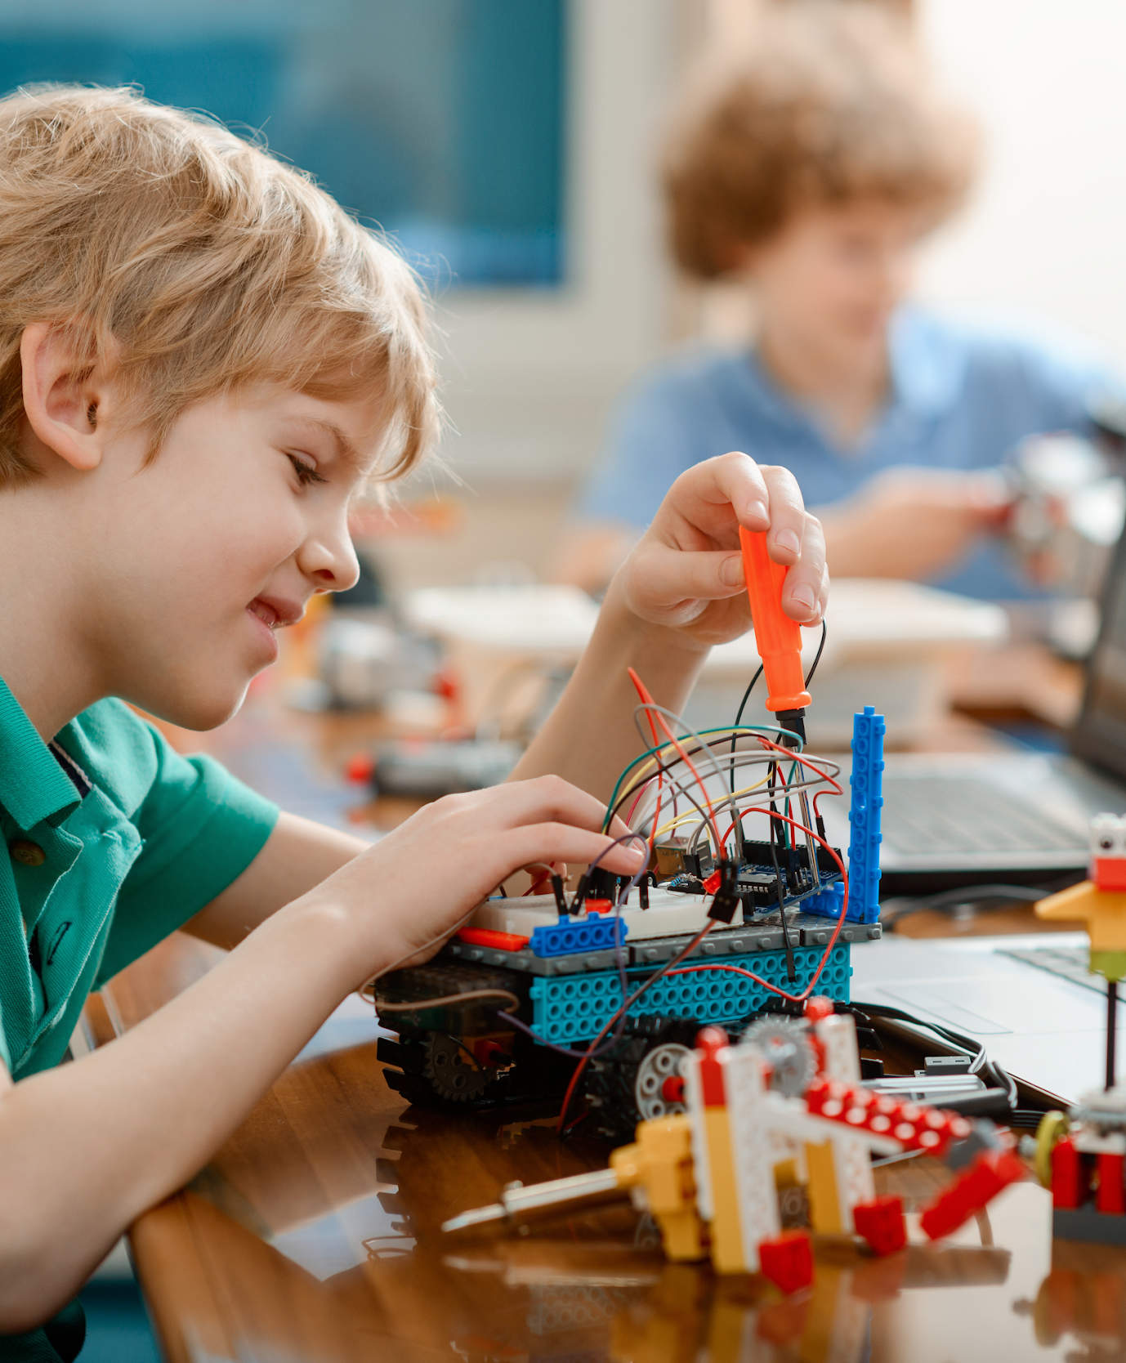
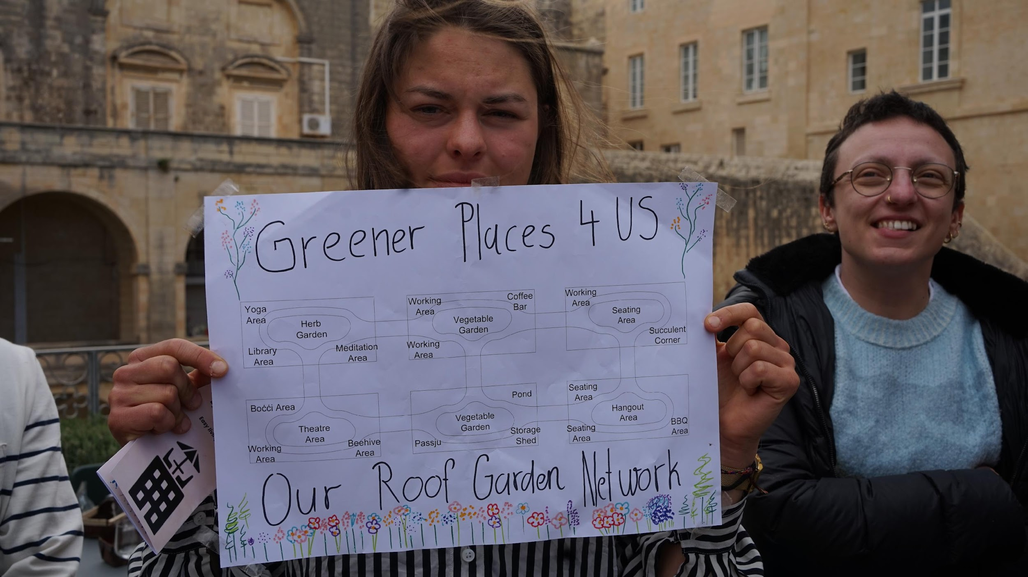
Key Objective:​
To create a road-map to support STEAM Education policy in Europe, focusing on the transition between secondary and tertiary education​
​
Methodology:​
Participatory methodology using collaborative dialogues and co-creation events across Europe​
Achieved through:​
Establishing criteria for analysis of effective STEAM Education​
Understanding the evidence base indicating the need for STEAM Education​
Understanding the current STEAM policy context​
Creating a conceptual framework to underpin STEAM policy and practice​
Mapping real-life case studies of effective STEAM practice​
Synthesising information into a policy road-map.​
​
Notes:
Kerry

Slide 7







DISCIPLINARY
INTER-RELATIONSHIPS
REAL-WORLD
CONNECTION
THINKING-MAKING-DOING
COLLABORATION
CREATIVITY
INCLUSION
PERSONALISATION
EMPOWERMENT

Slide 8
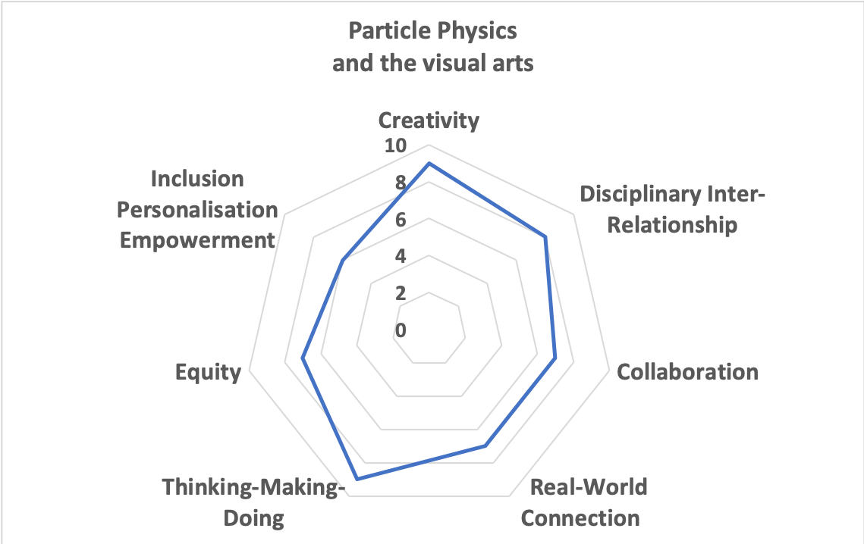
Apply the criteria to a HE activity
The community arts group In-Public is a collaboration with the University of Birmingham particle physics group to develop a series of practical workshops for primary and secondary schools. The workshops utilise the interrelationship between drawing, photography, sculpture and performance and offer an “art school” experience for students, pupils and adults as well as introducing particle physics. The ‘creativity’ and ‘Thinking-Making-Doing’ aspects of this practice are very strong, for this reason. However, there is no policy in place to reach those less likely to participate and workshop accessibility is limited, therefore ‘equity’ received a lower score.
https://www.road-steamer.eu/interactive-map-of-steam-practices/

Slide 9
Thank You

Slide 10
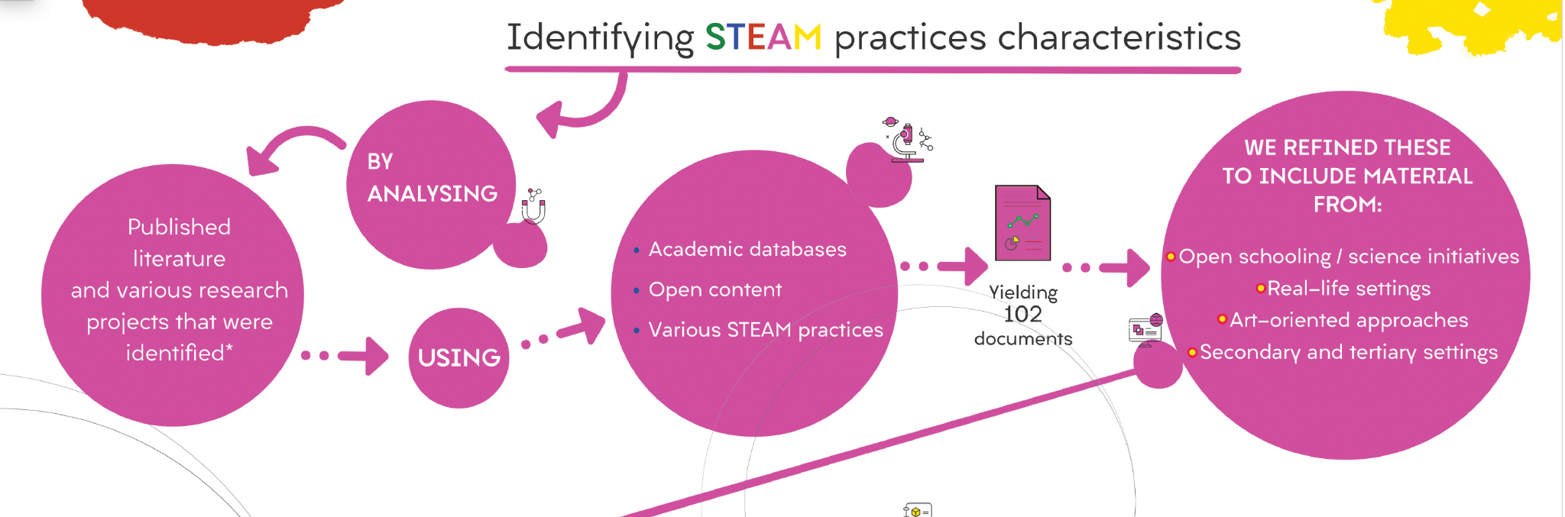
Notes:
Lindsay

Slide 11
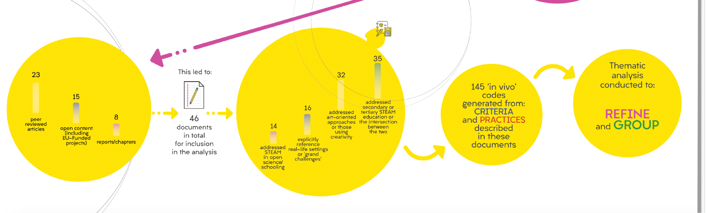
Notes:
Lindsay

