Slide 1
Streaming girls and women into STEAM education, innovation and research
April 3, 2025
FEMALE STUDENTS IN STEAM FIELDS ACROSS EUROPE
Réka Geambașu, “Babeș-Bolyai” University, Cluj, Romania
Funded by the European Union. Views and opinions expressed are however those of the author(s) only and do not necessarily reflect those of the European Union or the European Research Executive Agency. Neither the European Union nor the European Research Executive Agency can be held responsible for them.

Slide 2
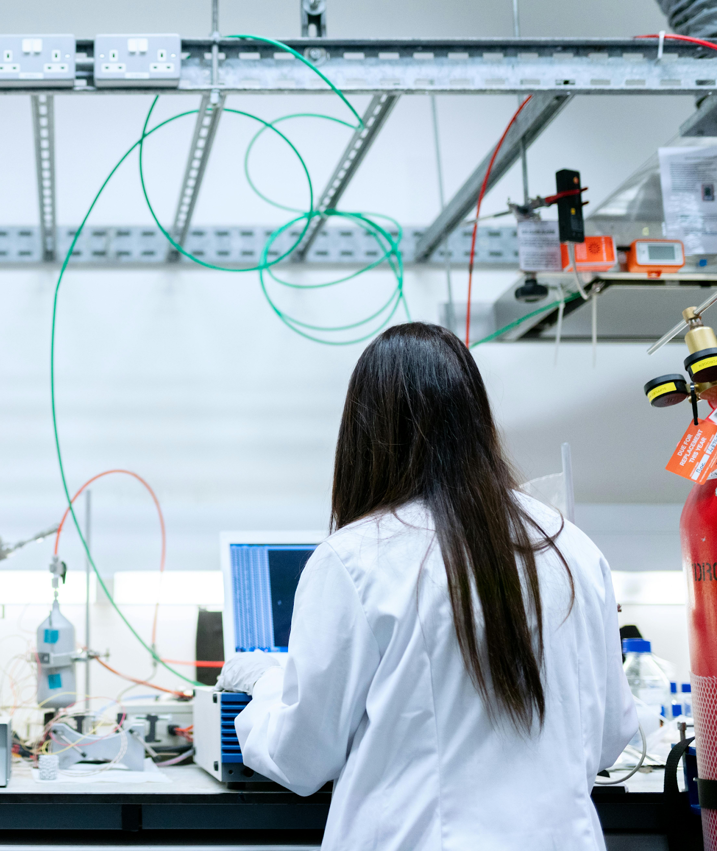
STREAM IT – Gender equality in STEAM education
Overview
Presentation of the research
Studying female students in STEAM domains – Objectives and Methodology
Main findings

Slide 3
STREAM IT – Gender equality in STEAM education
Presentation of the research
General objective:
existing knowledge
experiences and attitudes of female students
views and actions of stakeholders
Methods:
desk research
semi-structured interviews
expert interviews
literature review

Slide 4
STREAM IT – Gender equality in STEAM education
Female students in STEAM fields
Methodology:
97 semi-structured interviews in 16 European countries
346 journal articles and chapters
85 expert interviews in 14 European countries
Sample:
most interviewees: engineering, biology and ecology and computer science
equal distribution: BSc, MSc and PhD + 2 opt-outs
age: majority between 22 and 26 years

Slide 5
STREAM IT – Gender equality in STEAM education
Findings
Motivations:
personal interest and aptitude
influences from family and school
STEAM professions’ high social reputations and rich career opportunities

Slide 6
STREAM IT – Gender equality in STEAM education
Findings
Obstacles, challenges:
gender stereotypes and gendered expectations
incompatibility between women’s social roles and the representation of the STEM scientist or expert (“the ideal image”)
→ difficulties in balancing work and family
unwelcoming, “chilly climate”, lack of supportive social relations
Opportunities
inclusive environment
lack of social pressures
“time is on our side”
The issue of belonging in a qualitative approach

Slide 7
E-mail
www.streamit-project.eu
Website
info@streamit-project.eu
LinkedIn
https://www.linkedin.com/company/projectstreamit/
Facebook
https://www.facebook.com/profile.php?id=61558486186687
Instagram
https://www.instagram.com/projectstreamit/
Youtube
https://www.youtube.com/@projectstreamit
Funded by the European Union. Views and opinions expressed are however those of the author(s) only and do not necessarily reflect those of the European Union or the European Research Executive Agency. Neither the European Union nor the European Research Executive Agency can be held responsible for them.

Slide 8
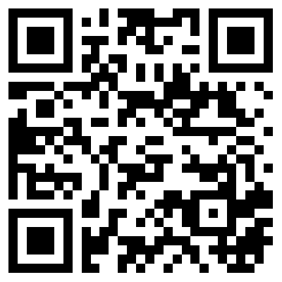
Scan the QR code and follow us
Funded by the European Union. Views and opinions expressed are however those of the author(s) only and do not necessarily reflect those of the European Union or the European Research Executive Agency. Neither the European Union nor the European Research Executive Agency can be held responsible for them.

