Slide 1
Bridging the gap between university and industry STE(A)M Learning Ecologies (SLEs) Project
Eleni Chatzidaki, PhD
Norwegian University of Science and Technology
(NTNU)

Slide 2
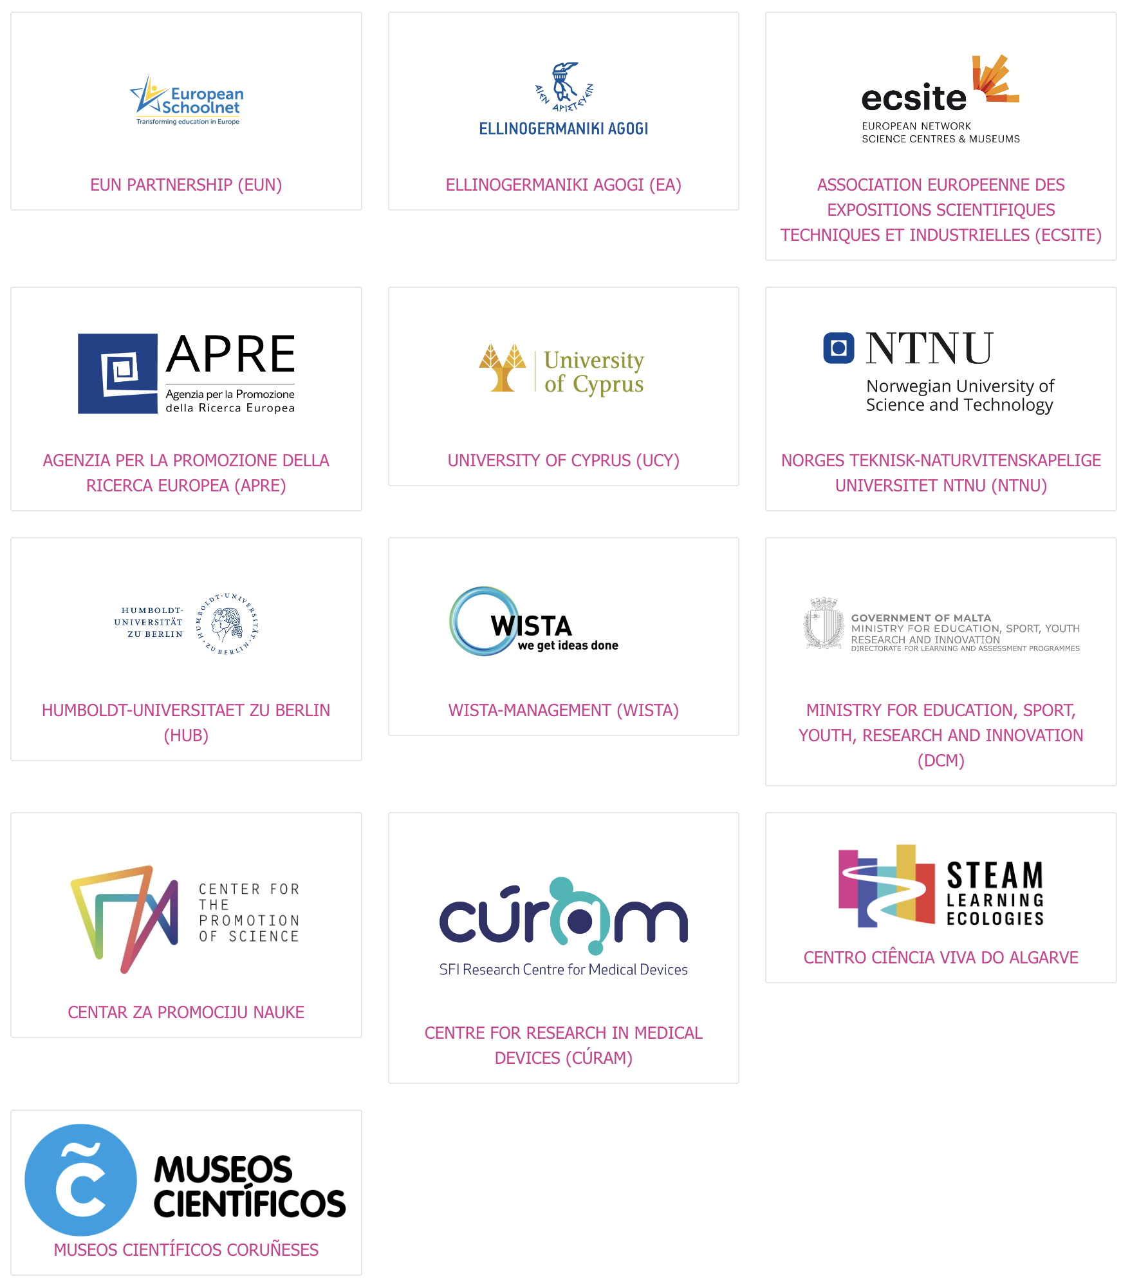
SLEs Project
Overview
Duration: 3-year Horizon Europe project – started the 1st January 2023
Funded by The European Commission
Implemented by 13 Consortium partners and linked Affiliated Parties from 11 countries across Europe
Coordinated by European Schoolnet

Slide 3
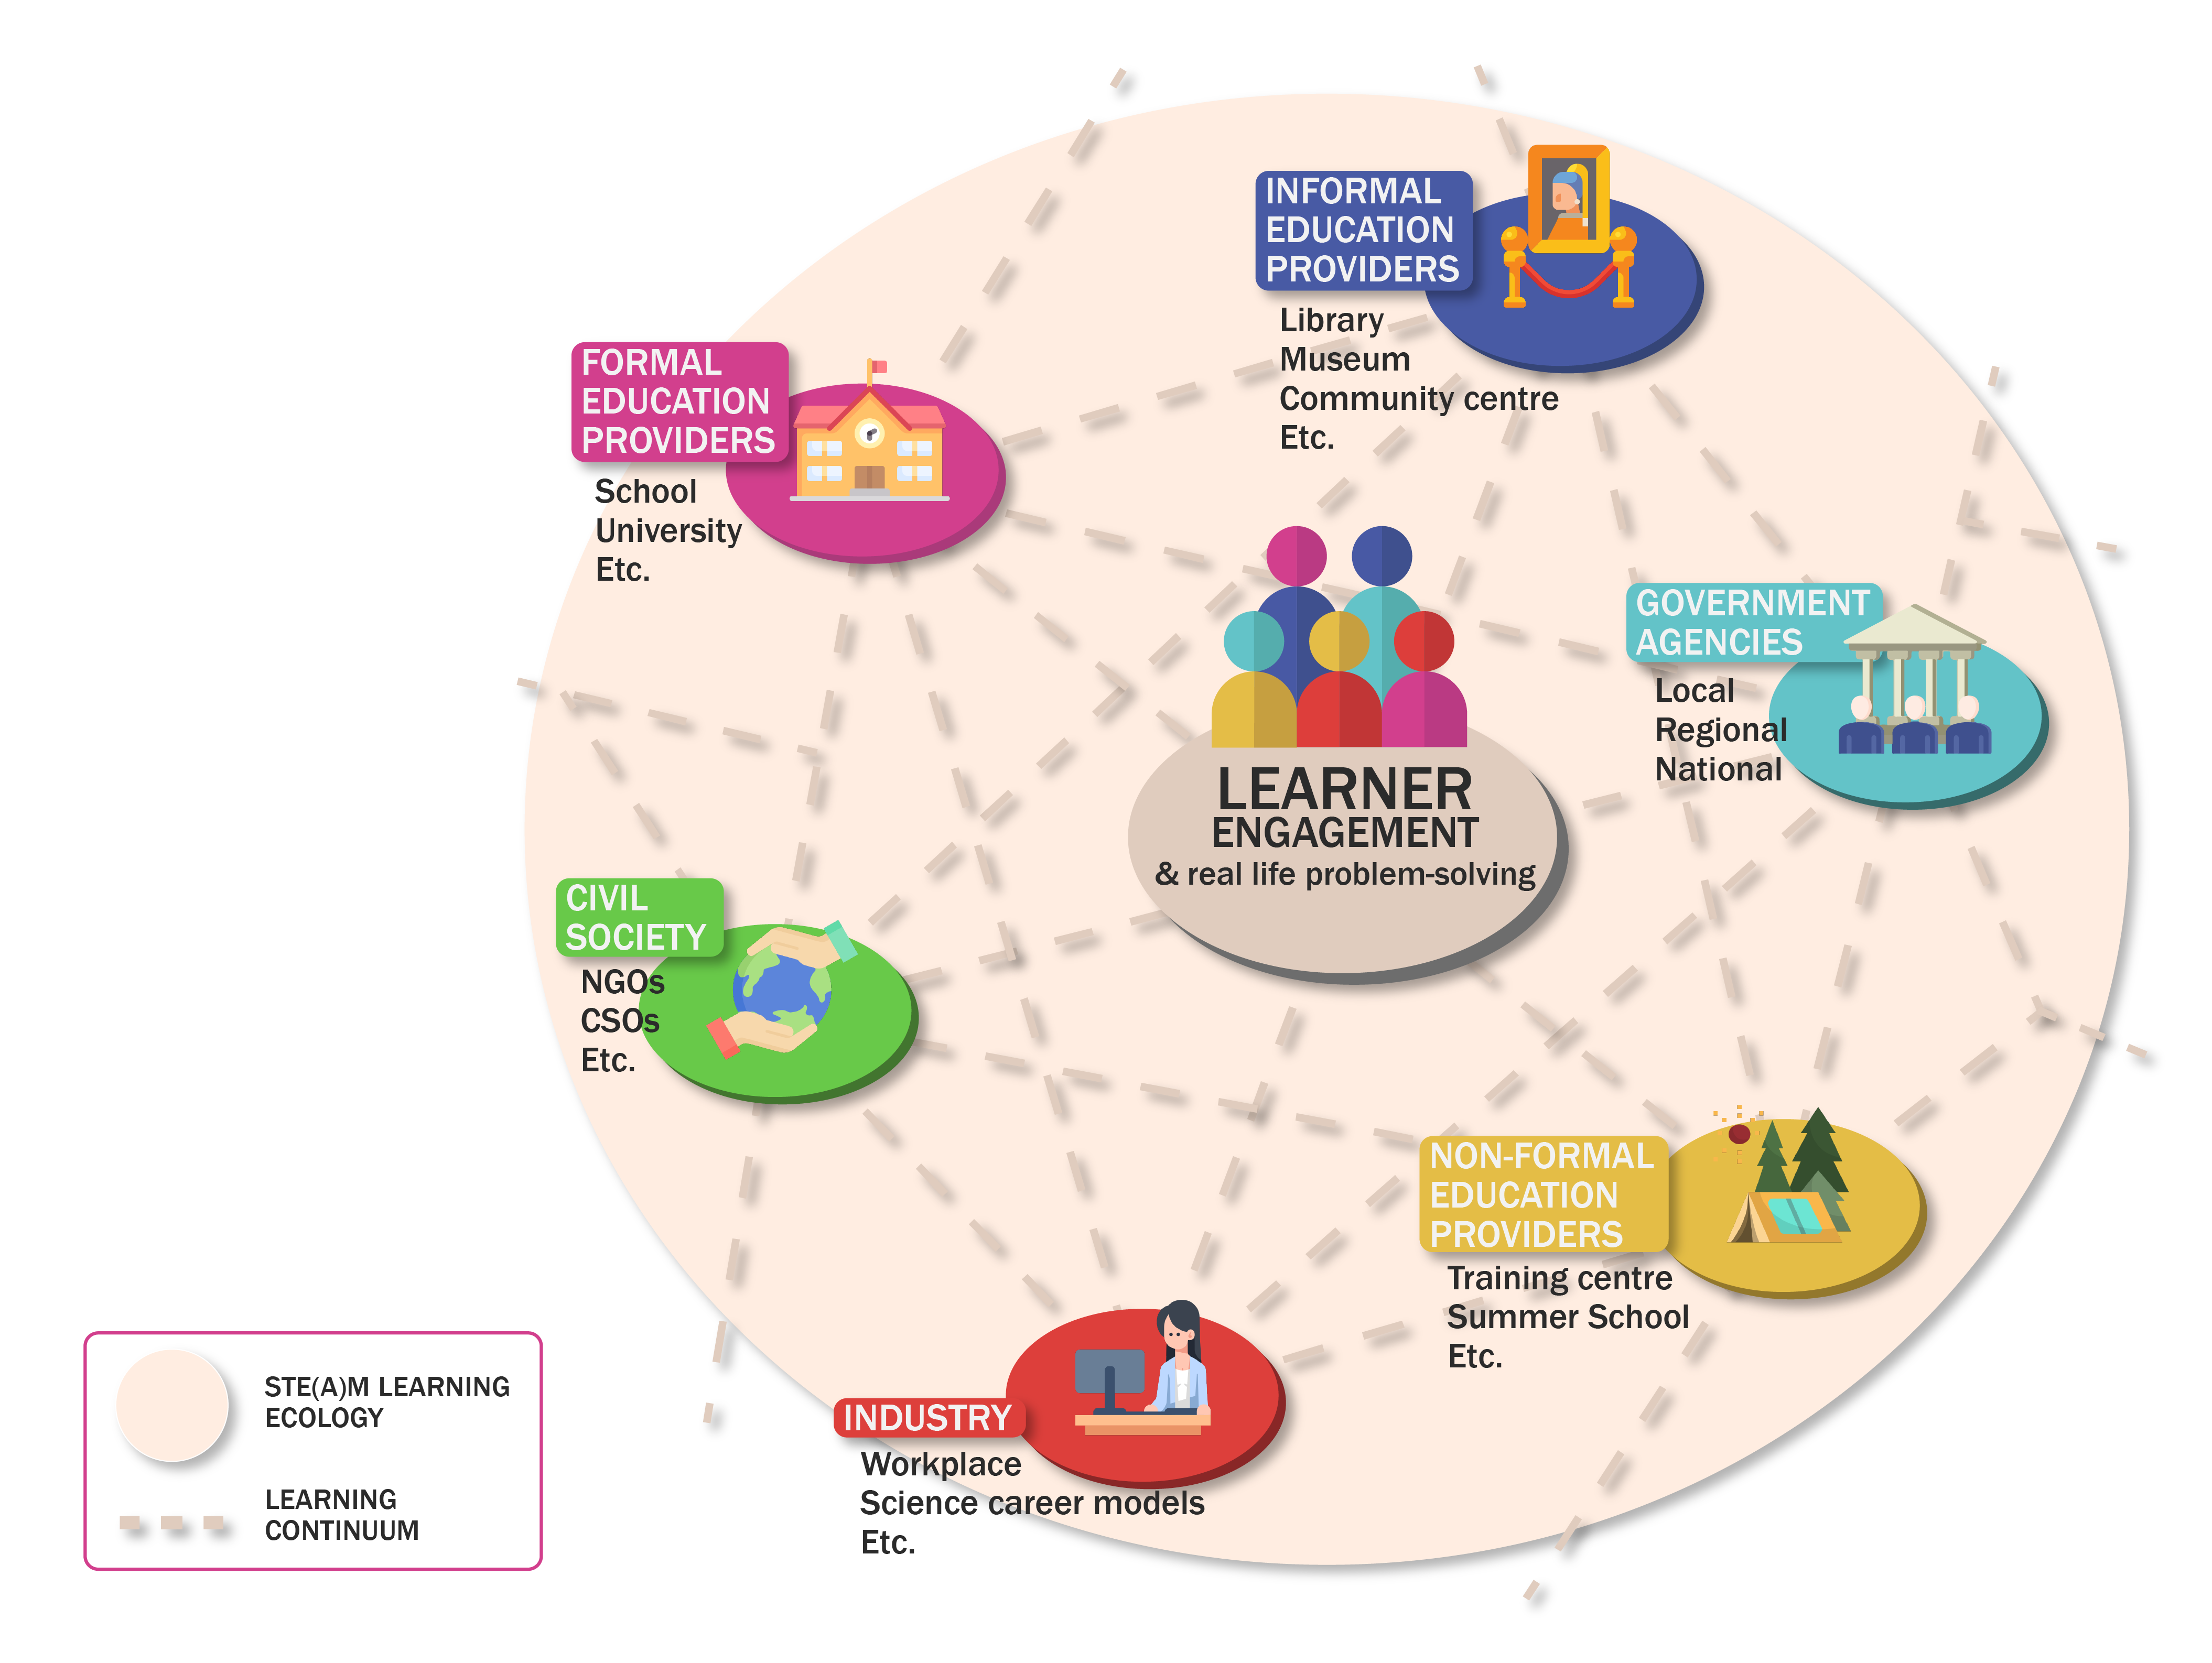
SLEs in a picture
OUR MAIN AIM
Create STE(A)M Learning Ecologies, new open schooling local partnerships between formal, non-formal and informal education providers, enterprises and civil society
Multiple science learning opportunities
Real-life problem solving situations
Co-created
Inclusive

Slide 4
SLEs constituent elements
STE(A)M (overarching approach)
Open schooling environment (main pillar)
Living lab practice (key practice)
SLEs vision

Slide 5
SLEs cycles timeline
Oct 2023
May 2024
Reflection workshops / methodology refinement
Oct 2024
May 2025
Oct 2023 – May 2023 First cycle: smaller-scale pilot implementation
Oct 2024- May 2025 Second cycle: large-scale mature implementation
13 pilot ecologies implemented. 600+ learners engaged
100 mature ecologies
Implemented. 2000+ learners engaged

Slide 6
Key dimensions of SLEs
Partnerships to foster networking, sharing and applying science and technology research findings amongst stakeholders
Mentoring across the partnership
Learner Meaningful Engagement in real-life problem-solving situations within different learning spaces
Learner future choices to encourage learners to follow STEM studies and careers and promote gender equality
From research to Enterprise to increase application of science and innovation research results into business
From Enterprise to Learning to link industry–based innovation with education and lifelong learning programmes

Slide 7
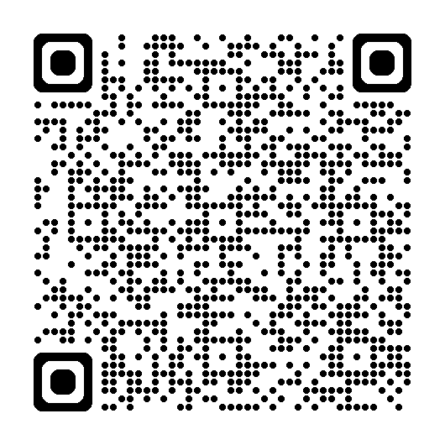
Outputs
SLEs Methodology
Pilots’ stories of implementation in the blog section
1st Policy Brief
2nd Policy Brief
Get a glimpse of the SLEs pilots
SLEs Portfolio: Real-Life Stories from the Ground Across 13 Countries! – SLE project

Slide 8
A Case Study from the SLE Project:
Customer Driven Project (CDP)

Slide 9
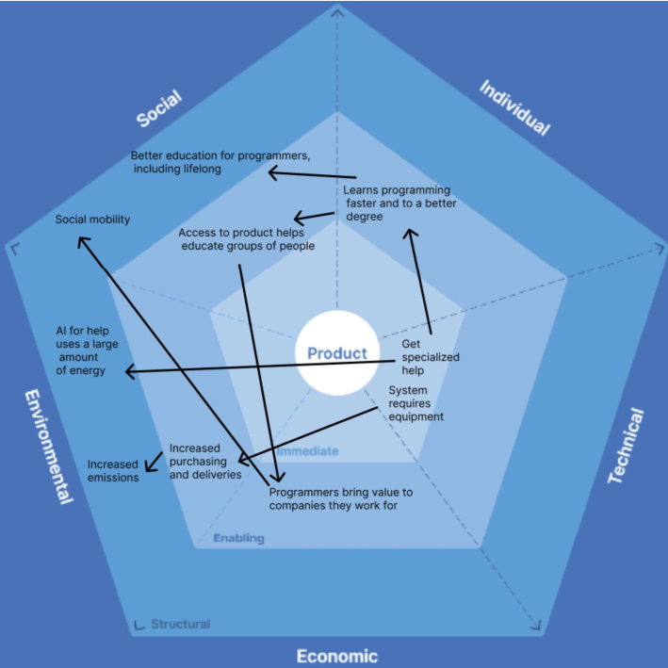
Customer Driven Project in a Nutshell
Bridging the gap between theory and practice, this Norwegian SLE invited university students aged 21 to 24 years old to create realistic software prototypes “on contract” for a real-world customer. The initiative raised participants’ software engineering skills, teaching the whole software development lifecycle, including project management and planning, requirements gathering, programming, testing, evaluation, and more.

Slide 10
Customer Driven Project SLE
Stakeholders
Challenge
Benefits
Professors and Teacher Assistants from the Norwegian University of Science and Technology,
Industries in the private sector (Information Technology, Engineering, Virtual Reality, AI)
Municipality of Trondheim
Public sector departments
Bridging the gap between university and industry in software engineering
Practical experience in executing all phases of large development projects and present results to a real customer
Insight into project work and how groups can be used to solve complex software engineering problems
Increased need for industry-compatible competences and relevant practical skills
Support for university students transitioning from academic settings to the professional world

Slide 11
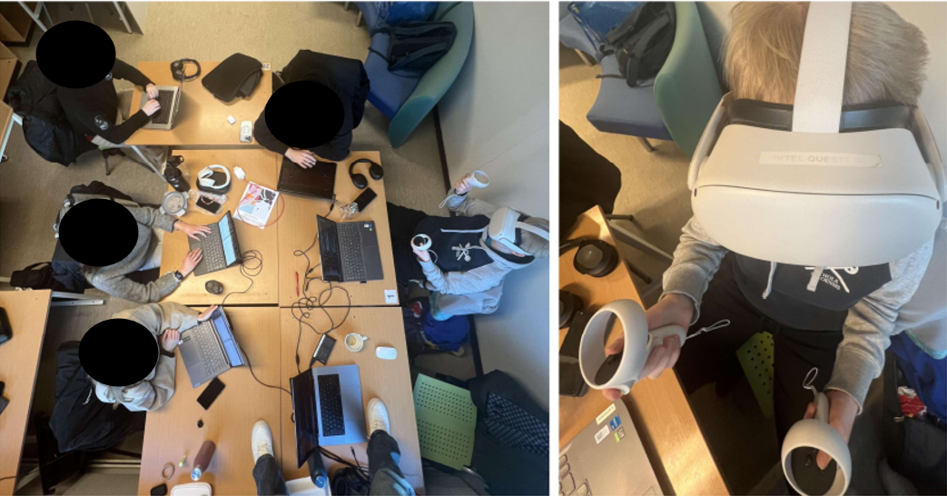
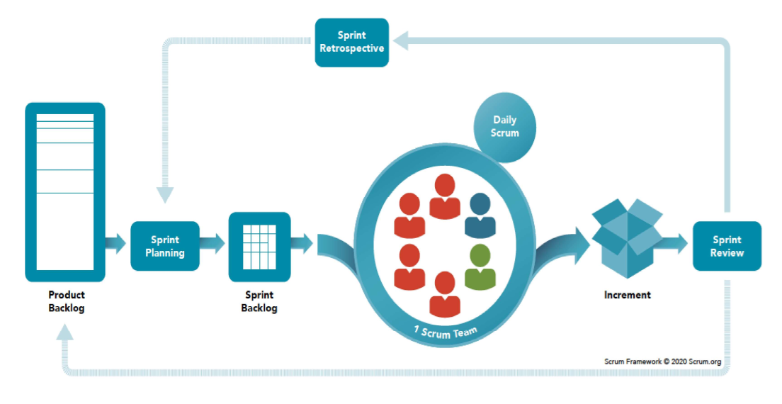
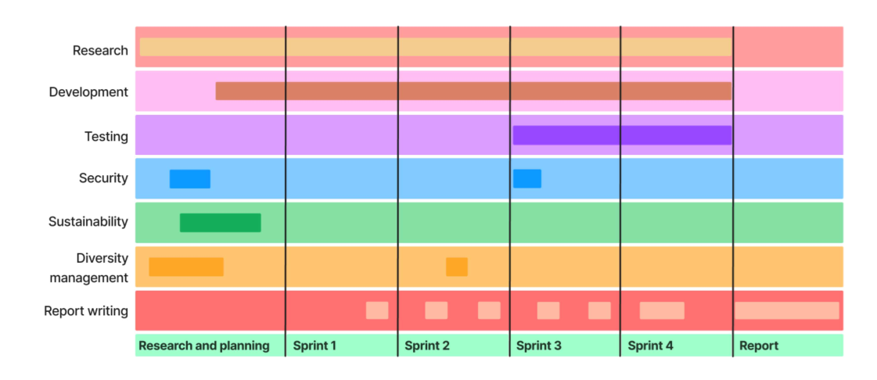
The Learning Artefacts
Delivery of the Minimum Viable Product – a software product with enough features to attract early-adopter customers
Production of a report explaining the whole development process
Students’ presentation on the project

Slide 12
Gender balance in the CDP
Year | N Teams | N Male (%) | N Female (%)
2017 | 14 | 70 (76.92%) | 21 (23.08%)
2018 | 14 | 66 (72.53%) | 25 (27.47%)
2019 | 14 | 80 (80.81%) | 19 (19.19%)
2020 | 17 | 90 (70.87%) | 37 (29.13%)
2021 | 14 | 62 (70.45%) | 26 (29.55%)
2022 | 12 | 43 (64.18%) | 24 (35.82%)
2023 | 11 | 34 (52.31%) | 31 (47.69%)
TOT | 85 | 445 (70.89%) | 183 (29.11%)

Slide 13
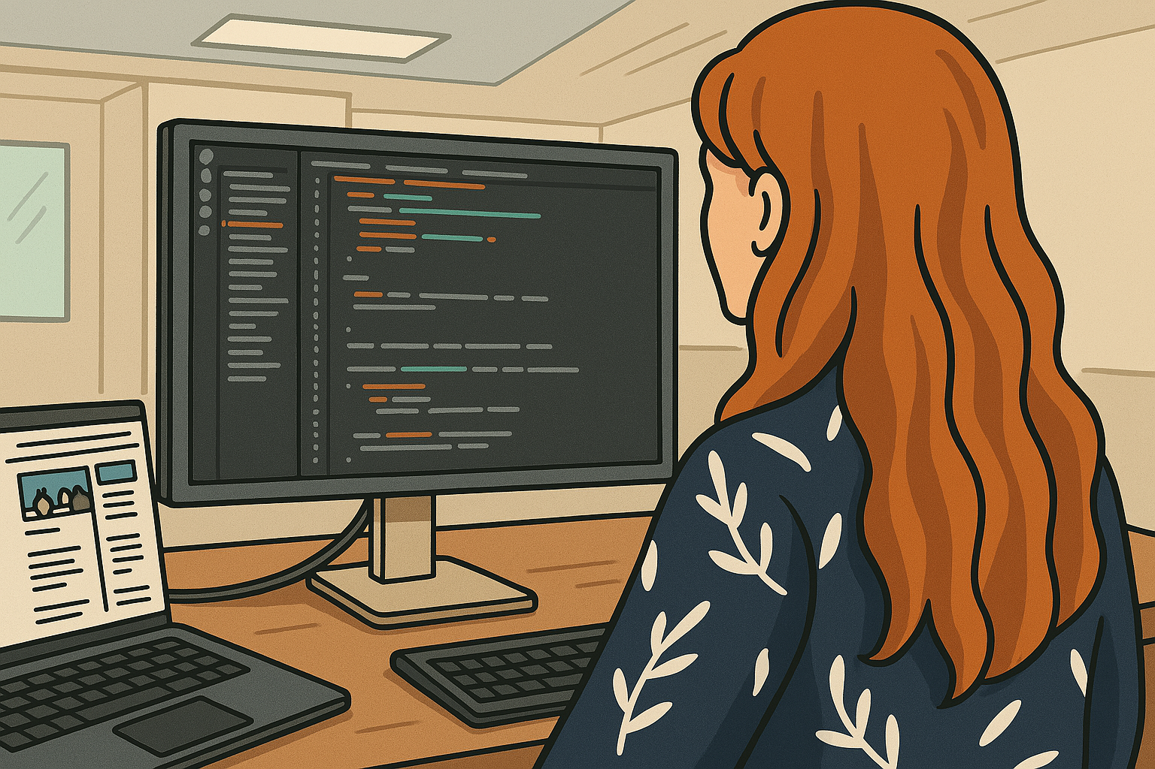
Gender Dynamics in Software Engineering: Insights from Research

Slide 14
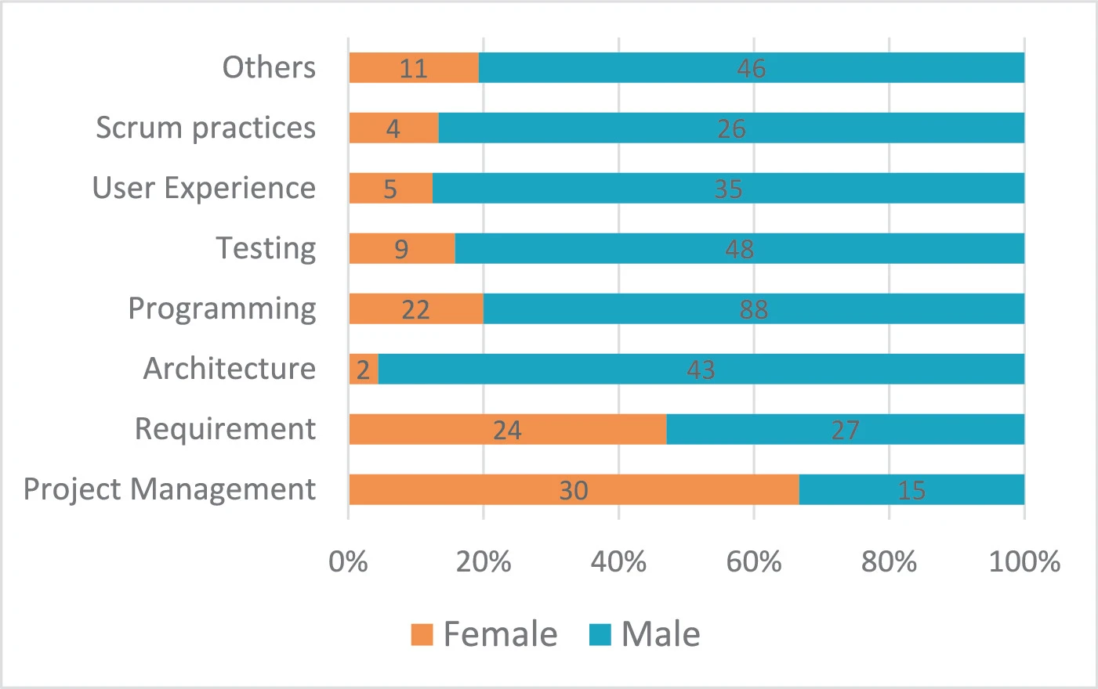
A study of female participation in CDP
Reference: “Gender equality in software engineering education–a study of female participation in customer-driven projects”, Nguyen-Duc, Anh; Jaccheri, Letizia. International Conference on Sustainability in Software Engineering & Business Information Management,39-49,2022,Springer International Publishing Cham.

Slide 15
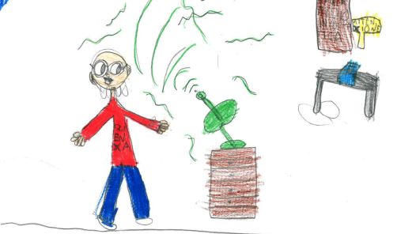
A study of Children’s Perceptions of SE
Sample: 371 primary school students (M = 8.4 years)
192 girls (M = 8.2),
166 boys (M = 8.5),
13 other (M = 8.0)
Drawings:
51% drew a man
44% drew a woman
5% gender-neutral/unidentifiable
Reference: “Draw a software engineer test-an investigation into children’s perceptions of software engineering profession”, Cutrupi, Claudia Maria; Zanardi, Irene; Jaccheri, Letizia; Landoni, Monica. 2023 IEEE/ACM 45th International Conference on Software Engineering: Software Engineering in Society (ICSE-SEIS),37-47,2023,IEEE.

Slide 16
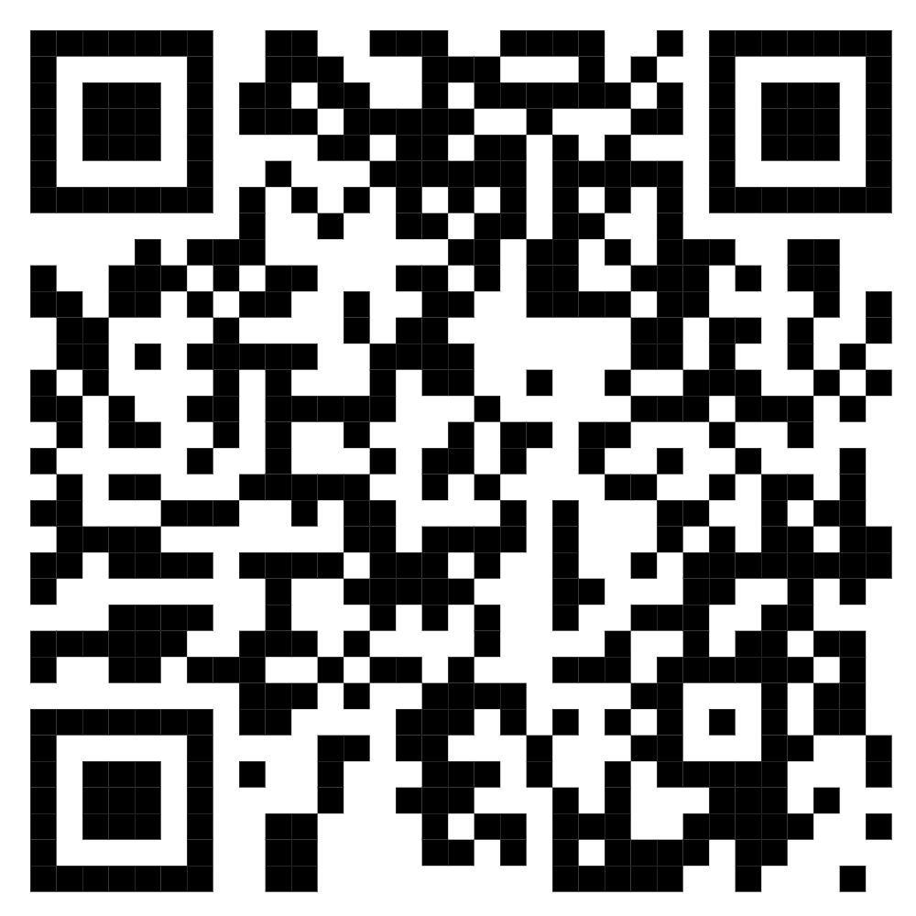
Thank you!
E-mail: eleni.chatzidaki@ntnu.no
Website: https://www.ntnu.edu/employees/eleni.chatzidaki
Learner Computer Interaction (LCI) Lab
https://lci.idi.ntnu.no/

Slide 17
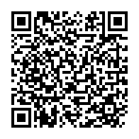
Join the International Community!
https://www.steamecologies.eu/join-the-steam-learning-ecologies-international-community/

