Slide 1

Gender Dimension in Research
Gender dimension in projects and funding opportunities on gender
Date. Facilitator’s name, email address.

Slide 2
Agenda
9.30 – 10.00 Welcome and Overview
10:00 – 11:30 Content Part 1. Gender Equality Plan in Horizon Europe Projects
11.30 – 11.45 Break
11:45 – 11.30 Content Part 2. Gender dimension in research projects
12.45 – 13.15 Content Part 3. EU funding opportunities on gender equality
13.15 – 13.30 Closure

Slide 3
Objectives and outcomes
Training Objectives
Introduce the essential requirements and benefits of the Gender Equality Plan (GEP) within Horizon Europe projects.
Explain the importance of the gender dimension in research and how it impacts research quality and relevance.
Familiarize with EU funding opportunities specifically designed to support gender equality in research projects.
Learning Outcomes
Understand and articulate the purpose and key requirements of a Gender Equality Plan (GEP) in Horizon Europe projects.
Identify specific ways to incorporate gender perspectives and gender-sensitive strategies across the research process, from proposal writing to project implementation, dissemination and evaluation.
Evaluate the gender responsiveness of existing research projects and recommend improvements.
Navigate EU funding options for gender-focused projects and understand the application requirements.

Slide 4
Glossary
Gender Balance: An equitable distribution of genders within a group, organization, or team, often with the goal of fostering diverse perspectives and reducing bias.
Gender Barriers: Obstacles that limit opportunities, resources, or fair treatment based on gender, often rooted in societal norms or institutional practices.
Gender-Based Violence: Any act of violence directed at an individual based on their gender, often intended to establish or reinforce gender-based power inequalities.
Gender Dimension: The integration of gender considerations into the design, implementation, and evaluation of policies, projects, or research to ensure that they benefit all genders fairly.
Gender Equality: The state of equal access to opportunities and resources, regardless of gender, aiming to eliminate gender-based discrimination and ensure fair treatment for all.​
Gender Equality Plan: A formal policy or document developed by an organization to promote equal opportunities and eliminate gender bias within the workplace or project environment.​
Gender Impact: The specific effects or outcomes that an action, policy, or program has on gender equality or the experiences of different genders.​
Gender Inequalities: Disparities in status, resources, opportunities, and treatment based on gender, often resulting from systemic biases or discrimination.​
​

Slide 5
Glossary
Gender Mainstreaming: A strategy in which gender perspectives are integrated into all stages of project planning, implementation, and evaluation, promoting equal opportunities and preventing gender-based discrimination.
Gender Quotas: A system of setting minimum requirements for gender representation in certain areas, such as employment or decision-making bodies, to promote gender equality.
Gendered Metaphors: Figurative language that reinforces gender stereotypes or assigns gendered characteristics to certain roles, objects, or actions.
Gender-Sensitive Lens: An approach or perspective that actively considers and addresses the different needs, roles, and experiences of individuals based on their gender.
Language Bias: The use of language that reinforces stereotypes or excludes certain groups, often unintentionally; this can include gendered terms or phrasing that favor one gender over another.
Mitigating Measures: Actions taken to reduce or counteract potential negative effects, such as policies or practices aimed at lessening gender-based barriers or biases.
Sexual Harassment: Unwanted or inappropriate behavior of a sexual nature that creates an intimidating, hostile, or offensive environment for the victim.
Unconscious Gender Biases: Implicit biases specifically related to gender, which can influence perceptions, decisions, and behaviors without conscious awareness, often perpetuating stereotypes and inequalities.
​

Slide 6
Agenda
9.30 – 10.00 Welcome and Overview
10:00 – 11:30 Content Part 1. Gender Equality Plan in Horizon Europe Projects
11.30 – 11.45 Break
11:45 – 11.30 Content Part 2. Gender dimension in research projects
12.45 – 13.15 Content Part 3. EU funding opportunities on gender equality
13.15 – 13.30 Closure

Slide 7

I. Gender Equality Plan in Horizon Europe Projects
Horizon Europe applicants that are public bodies, research organisations or higher education institutions established in a Member State an Associated Country must have a Gender Equality Plan (GEP) in place, fulfilling the four mandatory requirements and consider the recommended areas.

Slide 8
I. Gender Equality Plan in Horizon Europe Projects
Applicable to Horizon Europe calls from 2022 onwards
The GEP is requested at proposal stage in applications forms
The GEP must be in place for the signature of the Grant Agreement

Slide 9
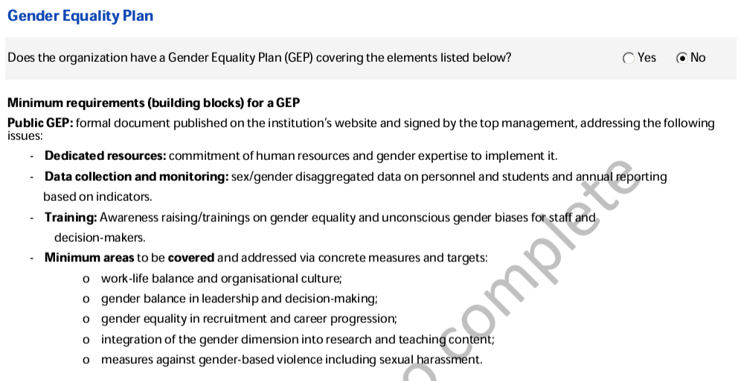
I. Gender Equality Plan in Horizon Europe Projects

Slide 10
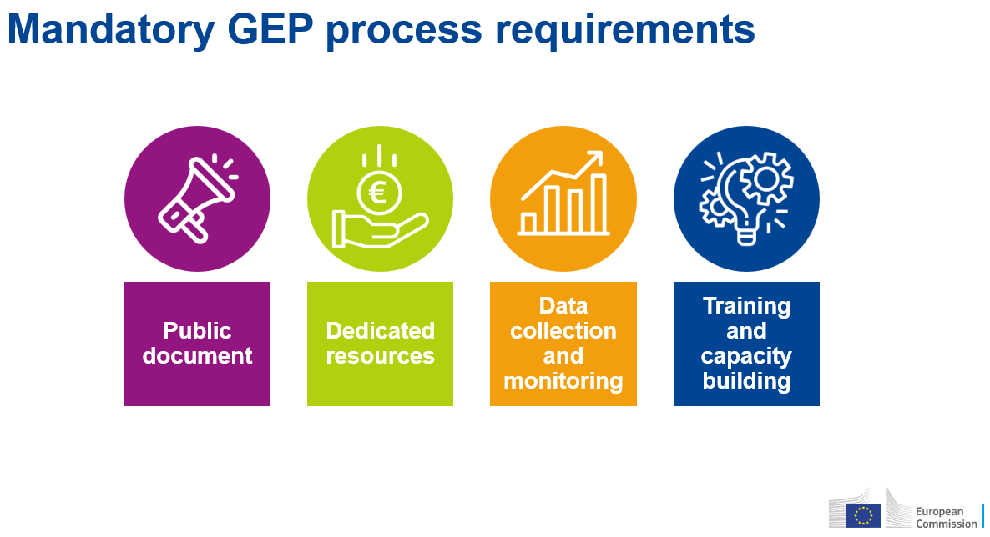
I. Gender Equality Plan in Horizon Europe Projects
Mandatory GEP process requirements
Source: https://ec.europa.eu/research/participants/docs/h2020-funding-guide/other/event220623.htm
Further information: Horizon Europe guidance on gender equality plans. GEAR tool

Slide 11

I. Gender Equality Plan in Horizon Europe Projects
Mandatory GEP process requirements
Formal document
Published on the organisation’s website
Signed by the top management
Actively communicated within the institution

Slide 12

I. Gender Equality Plan in Horizon Europe Projects
Mandatory GEP process requirements
Funding for gender equality positions or teams
Reserved time for others to work on gender equality
Examples: dedicated unit/department to Equal Opportunities, setting-up a Working Group to support the implementation of the GEP.

Slide 13

I. Gender Equality Plan in Horizon Europe Projects
Mandatory GEP process requirements
Data on sex or gender of staff across roles and leadership.
Data on sex or gender of student body.
Annual reports and evaluations of progress and outcomes with a set of indicators (more than 2) for staff and students.
GEECCO tutorial for data monitoring: https://www.tuwien.at/en/tu-wien/organisation/zentrale-bereiche/genderkompetenz/gender-in-der-forschung/geschlecht-innovation/geecco-results/evaluation-and-monitoring-tutorials
ACT Gender equality Audit and Monitoring tool: https://act-on-gender.eu/nes/gender-equality-audit-and-monitoring-geam-tool

Slide 14

I. Gender Equality Plan in Horizon Europe Projects
Mandatory GEP process requirements
Whole organisation engagement, with professors, students, administrative staff, decision makers and top management included.
Ongoing and long-term process.

Slide 15
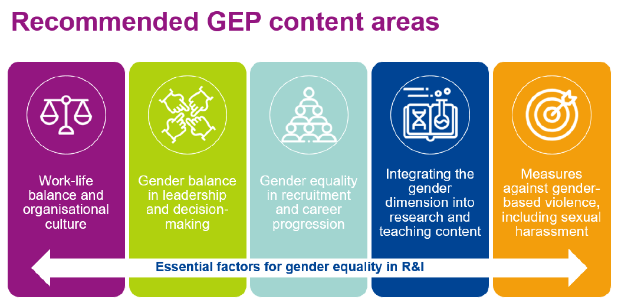
I. Gender Equality Plan in Horizon Europe Projects
Recommended GEP content areas

Slide 16
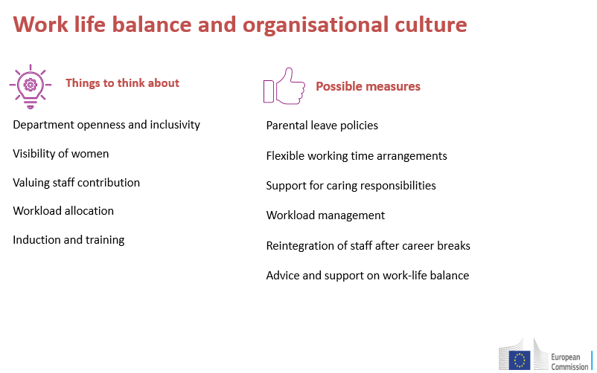
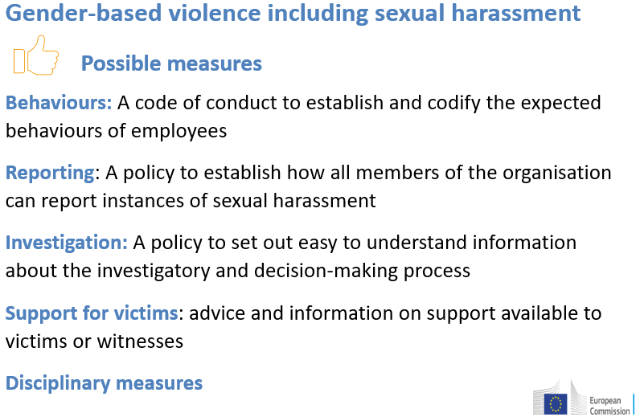
I. Gender Equality Plan in Horizon Europe Projects
Recommended GEP content areas

Slide 17
I. Gender Equality Plan in Horizon Europe Projects
Recommended GEP content areas

Slide 18
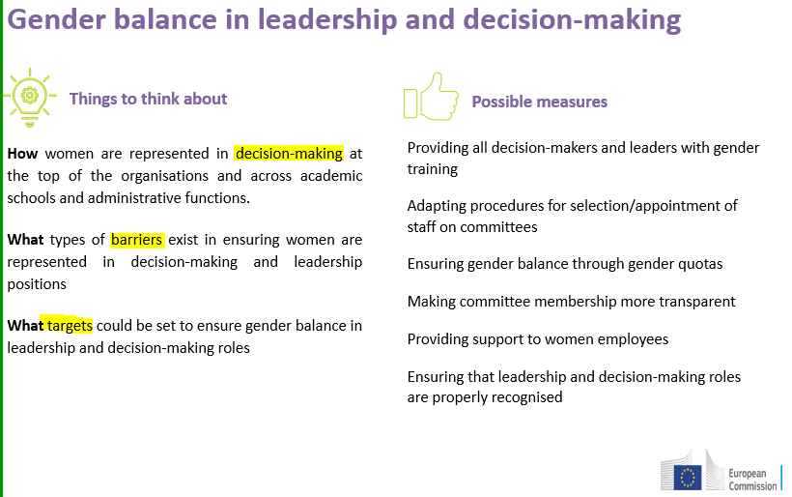
I. Gender Equality Plan in Horizon Europe Projects
Recommended GEP content areas

Slide 19
I. Gender Equality Plan in Horizon Europe Projects
Recommended GEP content areas

Slide 20
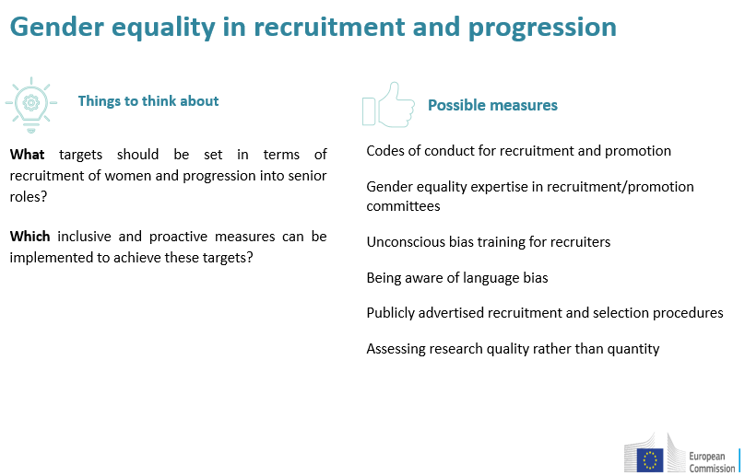
I. Gender Equality Plan in Horizon Europe Projects
Recommended GEP content areas

Slide 21
I. Gender Equality Plan in Horizon Europe Projects
Recommended GEP content areas

Slide 22
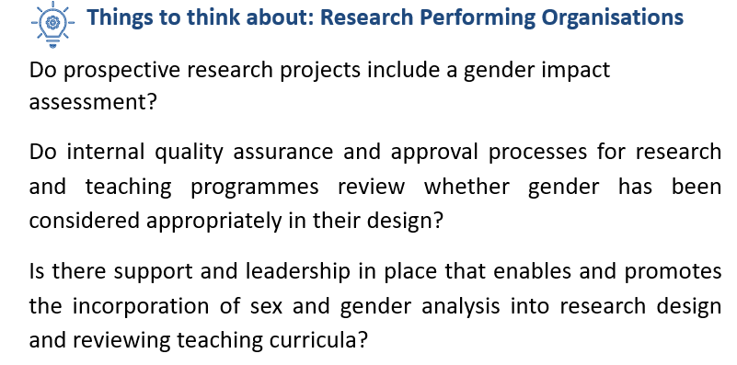
I. Gender Equality Plan in Horizon Europe Projects
Recommended GEP content areas

Slide 23
I. Gender Equality Plan in Horizon Europe Projects
Recommended GEP content areas

Slide 24
Group Activity 1
Potential obstacles and drawbacks | Solutions or actions to address them

Slide 25
Agenda
9.30 – 10.00 Welcome and Overview
10:00 – 11:30 Content Part 1. Gender Equality Plan in Horizon Europe Projects
11.30 – 11.45 Break
11:45 – 11.30 Content Part 2. Gender dimension in research projects
12.45 – 13.15 Content Part 3. EU funding opportunities on gender equality
13.15 – 13.30 Closure

Slide 26
II. Gender dimension in research projects
Excellence criteria
Project implementation criteria
Impact criteria
Annex 5. Specific rules. Model grant agreement
Measures to promote gender equality within a project
Work plan and resources
Budget and eligible costs
Evaluation

Slide 27
II. Gender dimension in research projects
Excellence criteria
[…] appropriate consideration of the gender dimension in research and innovation content.
  Describe how the gender dimension is taken into account in the project’s R&I content and training programmes.
  If you do not consider such a gender dimension to be relevant in your project, please provide a justification.
  Note: this question relates to the content of the planned R&I activities, and not to gender balance in teams in charge or carrying out the project
Source: Standard Application Form. HE Programme

Slide 28
II. Gender dimension in research projects
Excellence criteria
EXAMPLE. Rethinking Standards and Reference Models
Standards and reference models based on a single sex (or particular groups of men or women) can have damaging material consequences. For example:
Cardiac Health Misdiagnosis: Heart attack symptoms differ by sex, leading to misdiagnoses in women.
Vehicle Safety: Crash test dummies based on male anatomy raise injury risks for women.
Protective Equipment Fit: Safety gear often fits women poorly, reducing effectiveness and increasing risk.
Pharmaceutical Dosages: Male-based drug dosages cause side effects in women, who metabolize differently.
Source: https://genderedinnovations.stanford.edu/methods/standards.html

Slide 29
II. Gender dimension in research projects
Excellence criteria
EXAMPLE. Rethinking Standards and Reference Models
Workplace Ergonomics: Tools and workstations designed for men can lead to discomfort or injury for women.
Sports Equipment: Male-designed sports gear heightens injury risks for female athletes.
Sleep Studies: Male-based sleep studies result in guidance that doesn’t support women’s sleep patterns.
Mental Health Assessments: Male-focused stress responses lead to misdiagnosis in women for PTSD and depression.
Thermal Comfort: Office temperatures often favor men, leaving women uncomfortably cold and affecting productivity.
Source: https://genderedinnovations.stanford.edu/methods/standards.html

Slide 30
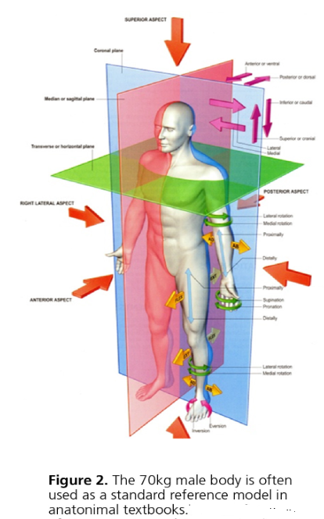
II. Gender dimension in research projects
Excellence criteria
EXAMPLE. Rethinking Standards and Reference Models
When analyzing human standards and reference models, researchers/engineers should consider the following questions:
Does the existing model differentiate between women, men, and gender-diverse people?
If a model does not consider sex, is it based on research in both sexes, or is it in fact a male/females reference model that is being used as a generic “human” model?
Does the existing model take into account differences between women’s, men’s, and gender-diverse people's needs, attitudes, and interests?
Source: https://genderedinnovations.stanford.edu/methods/standards.html

Slide 31
II. Gender dimension in research projects
Project implementation criteria
Quality and effectiveness of the work plan, suitability of the effort assigned to work packages and the resources overall is assessed.
Capacity of participants and consortium as a whole. […] show how the expertise in gender aspects of R&I as appropriate […]
Source: Standard Application Form. HE Programme

Slide 32
II. Gender dimension in research projects
Impact criteria
Credibility of the pathways to achieve the impacts specified in the work programme:
  state the target groups that would benefit,
  describe any requirements, potential gender barriers and the mitigating measures.
Source: Standard Application Form. HE Programme

Slide 33
II. Gender dimension in research projects
Impact criteria
Measures to maximise the expected impacts.
  describe the dissemination, exploitation and communication measures that are planned, and the target groups addressed.
Source: Standard Application Form. HE Programme

Slide 34
II. Gender dimension in research projects
Impact criteria
Identify potential target groups:
What are the characteristics of target users/communities? These may include sex, age, socioeconomic status, ethnicity, native language, etc.
Questions to include:
How will different groups of people (defined by sex, race, age, geographic location, etc.) be affected by this project/product?
What are their particular perspectives, needs and interests?
Whose practical knowledge or experience is relevant to this research or design project?
Source: https://genderedinnovations.stanford.edu/methods/co-creation.html

Slide 35
II. Gender dimension in research projects
Impact criteria
Seek user or community input:
Engage users/communities in defining problems, requirements, and solution and design alternatives
Ensure that your participant sample is heterogeneous enough to capture the various intersecting positions of relevance to the project
Source: https://genderedinnovations.stanford.edu/methods/co-creation.html

Slide 36
II. Gender dimension in research projects
Annex 5. Specific rules. Model grant agreement
VALUES-ARTICLE 14
Gender mainstreaming
The beneficiaries must take all measures to promote equal opportunities between men and women in the implementation of the action and, where applicable, in line with the gender equality plan.
They must aim, to the extent posible, for a gender balance at all levels of personnel assigned to the action, including at supervisory and managerial level.
Source: ANNEX 5. SPECIFIC RULES. MODEL GRANT AGREEMENT

Slide 37
II. Gender dimension in research projects
Measures to promote gender equality within a project
Transparency of recruitment and working conditions
Plans and conditions for career development
Transparent gender equal wage classification and granding of jobs
Setting up a gender balance quota in new hires within the project
Appointing a Gender Issues Advisor within the project/within the Advisory Board
Setting up a Gender Plan as a project deliverable (in M6 with regular updates).
Trainings on unconscious gender biases in recruitment and gender issues in research
The EU Charter and the Code of Conduct for the Recruitment of Researchers.
Human Resources Strategy for Researchers
Source: ANNEX 5. SPECIFIC RULES. MODEL GRANT AGREEMENT

Slide 38
II. Gender dimension in research projects
Measures to promote gender equality within a project
Plan for dissemination and communication “with gender dimension”. Admissibility condition in Horizon Europe projects.
Use of gender-sensitive communication, including the translations into participants’ native languages and removing gender stereotypes.
Setting up “raise awareness on gender issues” workshop and activities with researchers and students. Ex: “Gender Balance in STEAM fields”.
Setting up jointly activities with gender-based projects and with sister projects.
Ex: round table about gender issues with sister projects.
Setting up project actions in collaboration with the departments and units of participants dedicated to gender issues and in charge of the Gender Equality Plan.

Slide 39
II. Gender dimension in research projects
Measures to promote gender equality within a project
Adoption of family-friendly policies. Example: Trips Tues.-Weds.-Thurs.
Setting up sex and gender analysis, adding tables, figures and descriptions of the gender/sex findings, if any.
Visibility: when publishing results, take into account magazines and websites specialised in gender aspects and policy briefs. Example: Gendered Innovations
Measures to prevent and address gender-based violence such as sexual harassment.
Gender planning and budgeting

Slide 40
II. Gender dimension in research projects
Measures to promote gender equality within a project
GOVERNANCE STRUTURE AND BODIES
Is there a gender balance in the project consortium and team, at all levels and in decision-making positions?
Advisory boards​
General Assembly/Steering Committee​
Stakeholders, policy makers and decision makers​
Work packages leaders​
Project coordinators​
Main researchers​
Job opportunities within the project lifetime​

Slide 41
II. Gender dimension in research projects
Measures to promote gender equality within a project
RETHINKING LANGUAGE AND VISUAL REPRESENTATIONS
How might metaphors be gendered and create unintended hypotheses?
Do gendered metaphors reinforce stereotypes?
Are word choices or naming practices gendered?
Do naming practices or pronoun choices exclude gender/diverse individuals?
How does nomenclature influence who becomes scientist or engineer?
Are the images being used gender inclusive?
Source https://genderedinnovations.stanford.edu/methods/language.html

Slide 42
II. Gender dimension in research projects
Measures to promote gender equality within a project
RETHINKING LANGUAGE AND VISUAL REPRESENTATIONS
Are graphs, charts, or images used to visualize abstract concepts gendered on unintended ways?
Does a particular field of engineering promote a self-image that carries messages about the gender appropriateness of participation by women, men, and gender-diverse people?
Are problem sets or training exercises chosen to illustrate basic scientific principles gendered in unintended ways?
Source https://genderedinnovations.stanford.edu/methods/language.html

Slide 43
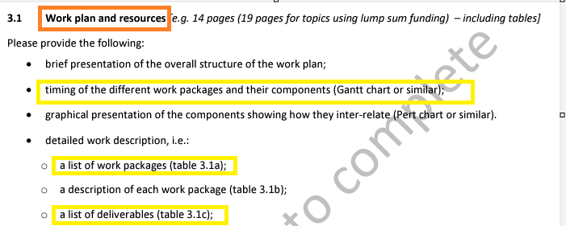
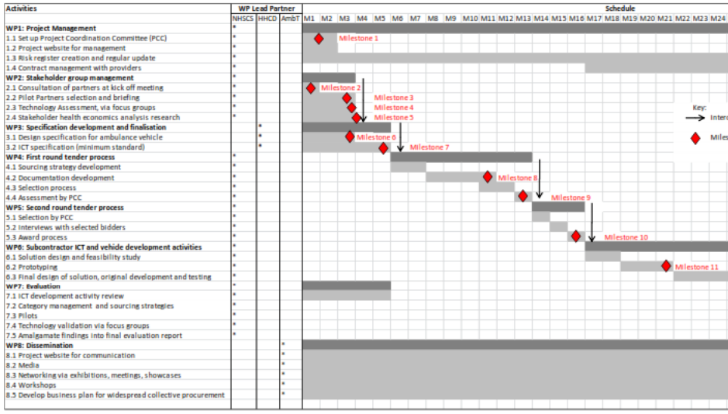
II. Gender dimension in research projects
Work plan and resources
If there are specific tasks in the project to address the gender dimension, this should be reflected in the work plan through specific work packages, milestones and/or deliverables.

Slide 44
II. Gender dimension in research projects
Work plan and resources
Timing and Scheduling (Gantt Chart):
  Are there milestones that address gender aspects within each work package?
  Have review points been scheduled to assess gender considerations throughout the project?
Graphical Representation of Interconnected Components:
  How are gender-relevant tasks connected to other project components?
  Are gender-integrated work packages clearly highlighted in the visual layout?
Detailed Work Description (Work Packages and Deliverables):
  Does each work package description specify how it addresses gender perspectives?
  Are there deliverables focused on analyzing or implementing gender-related insights?
  Does the work package description use gender-sensitive language throughout?

Slide 45
II. Gender dimension in research projects
Budget and eligible costs
GOODS AND SERVICES
  Travel costs. Example: the European Conference on Gender Equality in Higher Education
  Gender expert services. Example: Expert recommendations on which aspects reinforce or reduce inequalities and which promote equality with respect to the status quo and on how the research project can reduce gender inequalities and promote gender equality.
  Training costs. Examples: Training on Methods and Techniques for Integrating Sex and Gender into Research content, training for data collection with humans and the analysis of data from human participants.
  Costs of dissemination and communication actions with gender dimension

Slide 46
II. Gender dimension in research projects
Budget and eligible costs
PERSONNEL COSTS
  Working hours devoted to including gender dimension

Slide 47
II. Gender dimension in research projects
Evaluation
The gender dimension is only considered in relation to project management, however, social practices do have a strong gender dimension which is insufficiently addressed in the proposal.
Gender considerations are limited to avoid gender bias in studies involving human participants.
While the action addresses how to improve the gender balance of the photonics sector with actions specifically targeting young women, the methodology is described in general terms and specific action lacks clarity.
The Gender dimension has been mentioned only in a general manner and is not properly addressed.
The consortium partners adequately demonstrate their knowledge and commitment to enable gender aspects of R&I.
Source:proposals presented by Universitat Politècnica de Catalunya 2019-2022

Slide 48
Group Activity 2
Evaluate the ergonomic design of current agricultural machinery used in vineyard management across Southern Europe
Brainstorm five ways to integrate a gender perspective into this research. You can consider research design and participants, methodology and data collection, analysis, and/or dissemination.
1 | 2 | 3 | 4 | 5

Slide 49
Agenda
9.30 – 10.00 Welcome and Overview
10:00 – 11:30 Content Part 1. Gender Equality Plan in Horizon Europe Projects
11.30 – 11.45 Break
11:45 – 11.30 Content Part 2. Gender dimension in research projects
12.45 – 13.15 Content Part 3. EU funding opportunities on gender equality
13.15 – 13.30 Closure

Slide 50
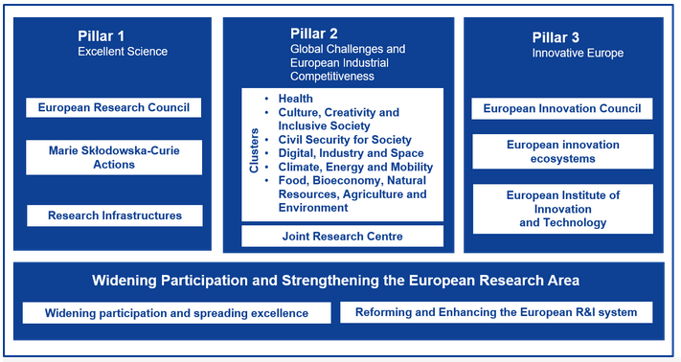
III. EU funding opportunities on gender equality
Source: Participation in Horizon Europe

Slide 51
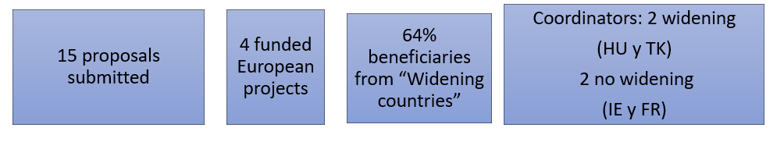
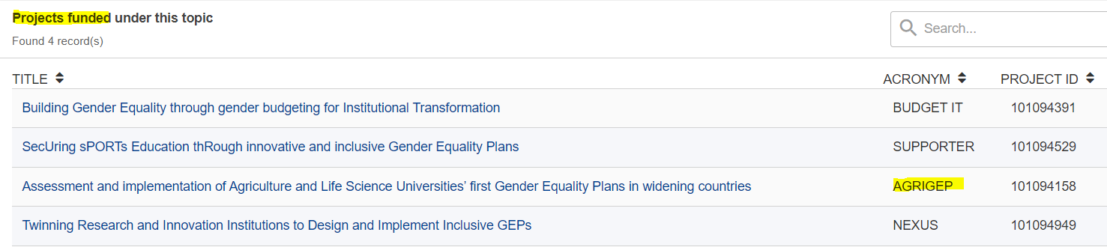
III. EU funding opportunities on gender equality
2022
AGRIGEP is an example of a project that was founded through a specific Horizon call on gender equality.
HORIZON-WIDERA-2022-ERA-01-81: Support to the implementation of inclusive GEPs
Source: https://ec.europa.eu/info/funding-tenders/opportunities/portal/screen/opportunities/topic-details/horizon-widera-2022-era-01-81

Slide 52
III. EU funding opportunities on gender equality
2024
TOPIC | TITLE
HORIZON-WIDERA-2024-01-10 | Policy coordination to support all aspects of inclusive Gender Equality Plans and policies in the ERA
HORIZON-WIDERA-2024-01-11 | Support to the implementation of inclusive gender equality plans
Source: Work Programme 2023-2024 Widening participation and strengthening the European Research Area

Slide 53
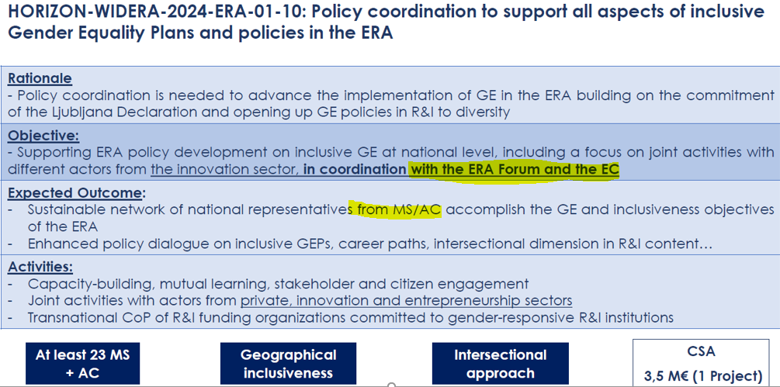
III. EU funding opportunities on gender equality
2024

Slide 54
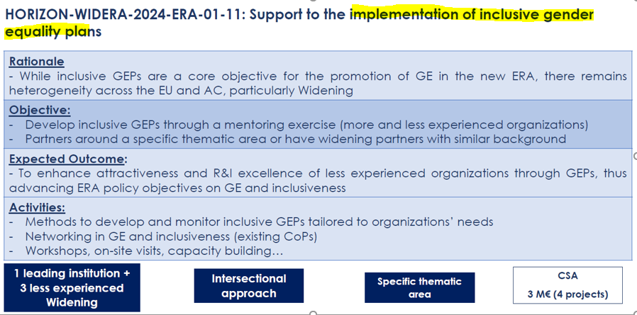
III. EU funding opportunities on gender equality
2024
0,5-1 m€ per project
Deadline: 12.03.24

Slide 55
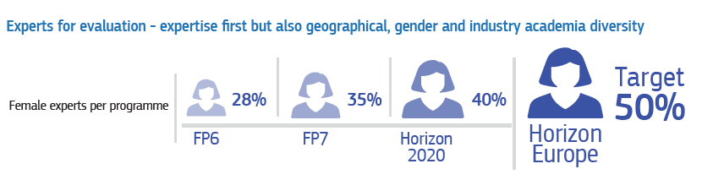
III. EU funding opportunities on gender equality
Horizon Europe. Work as an expert
The European Union Institutions appoint external experts to assist in the evaluation of grant applications, projects and tenders, and to provide opinions and advice in specific cases.
Register as expert: https://ec.europa.eu/info/funding-tenders/opportunities/portal/screen/work-as-an-expert

Slide 56
Recommended sources
Gender Inclusivity Dissemination Guidelines
How to integrate the gender dimension into #HorizonEU clusters & missions,
A thematic collection of innovative EU-funded research results
Report on Implicit Gender Biases During Evaluation
Gender decoder: this site to check whether a job advert has the kind of subtle linguistic gender-coding that has this discouraging effect.
New tools for gender analysis. Jeremy Berg. ScienceMag.org
Video on Gendered Innovations and video produced by MSCA
Toolkit for integrating gender-sensitive approach into research and teaching
Gender and Inclusion Toolbox: Participatory Research in Climate Change and Agriculture. CGIAR Research
Yellow Window Toolkit for Gender in EU-Funded Research

Slide 57

Exit questionnaire
Before you go, we'd love to hear your feedback.
Please scan the QR code to complete a quick exit survey.

Slide 58
Gender Dimension in Research
Gender dimension in projects and funding opportunities on gender
Date. Facilitator’s name, email address.

