Slide 1
Hands-on in Including Gender in Agrifood Systems Teaching
Date
Facilitator’s name and email address
Notes:
After the introduction of the facilitator and a brief presentation of the Agrigep project (to be designed by the facilitator if considered), it is recommended to highlight some EU policies that show the relevance of the topic from a decision-making point of view. Some key EU policies:
1995 Beijing conference where the word ‘gender’ appeared for the first time,
2007 Council of Europe issued a recommendation on gender mainstreaming in education,
2015 Paris declaration and Commission/Council for non-discrimination,
2015 launched and adopted the European Framework for Education 2030 equal opportunity for all, guidelines started to appear
Be sure that the audience know the difference between sex and gender.

Slide 2
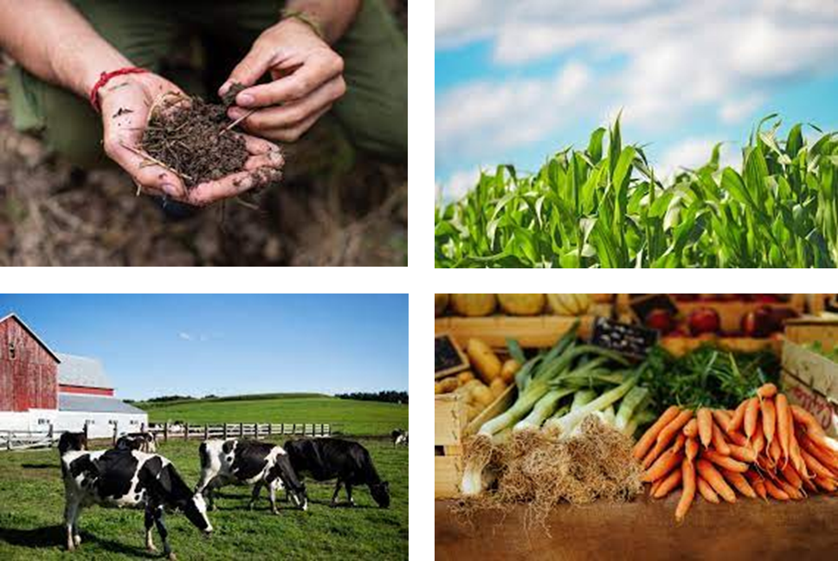
Agenda
Time | Program
9.30 – 9.55 | Introduction and expectations
9.55 – 10.30 | Agrifood systems context – facts and figures
10.30 – 11.30 | Gender in teaching – fundamentals (1)
11.30 – 11.45 | Break
11.45 – 12.20 | Gender in teaching – fundamentals (2)
12.20 – 13.05 | Agrifood systems examples
13.05 – 13.15 | Towards the institutional transformation
13.15 – 13.30 | Key lessons from the day and evaluation

Slide 3
Glossary
Gender Balance: An equitable distribution of genders within a group, organization, or team, often with the goal of fostering diverse perspectives and reducing bias.
Gender Barriers: Obstacles that limit opportunities, resources, or fair treatment based on gender, often rooted in societal norms or institutional practices.
Gender-Based Violence: Any act of violence directed at an individual based on their gender, often intended to establish or reinforce gender-based power inequalities.
Gender Dimension: The integration of gender considerations into the design, implementation, and evaluation of policies, projects, or research to ensure that they benefit all genders fairly.
Gender Equality: The state of equal access to opportunities and resources, regardless of gender, aiming to eliminate gender-based discrimination and ensure fair treatment for all.​
Gender Equality Plan: A formal policy or document developed by an organization to promote equal opportunities and eliminate gender bias within the workplace or project environment.​
Gender Impact: The specific effects or outcomes that an action, policy, or program has on gender equality or the experiences of different genders.​
Gender Inequalities: Disparities in status, resources, opportunities, and treatment based on gender, often resulting from systemic biases or discrimination.​
​

Slide 4
Glossary
Gender Mainstreaming: A strategy in which gender perspectives are integrated into all stages of project planning, implementation, and evaluation, promoting equal opportunities and preventing gender-based discrimination.
Gender Quotas: A system of setting minimum requirements for gender representation in certain areas, such as employment or decision-making bodies, to promote gender equality.
Gendered Metaphors: Figurative language that reinforces gender stereotypes or assigns gendered characteristics to certain roles, objects, or actions.
Gender-Sensitive Lens: An approach or perspective that actively considers and addresses the different needs, roles, and experiences of individuals based on their gender.
Language Bias: The use of language that reinforces stereotypes or excludes certain groups, often unintentionally; this can include gendered terms or phrasing that favor one gender over another.
Mitigating Measures: Actions taken to reduce or counteract potential negative effects, such as policies or practices aimed at lessening gender-based barriers or biases.
Sexual Harassment: Unwanted or inappropriate behavior of a sexual nature that creates an intimidating, hostile, or offensive environment for the victim.
Unconscious Gender Biases: Implicit biases specifically related to gender, which can influence perceptions, decisions, and behaviors without conscious awareness, often perpetuating stereotypes and inequalities.
​

Slide 5
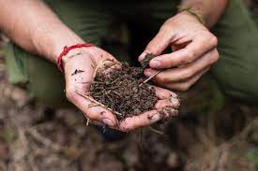

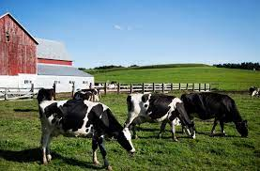

Contents
Agrifood systems context
Gender in teaching
Agrifood systems examples
Towards the institutional transformation
Recommended readings
Final remarks

Slide 6
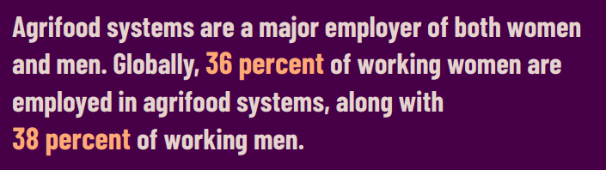
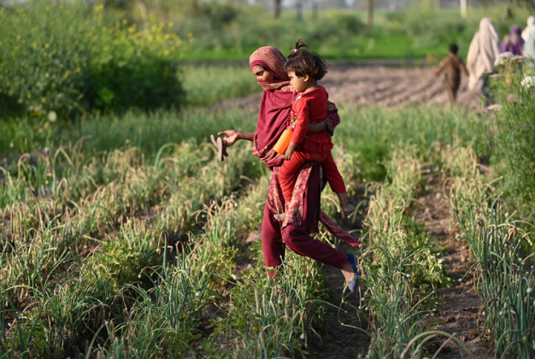

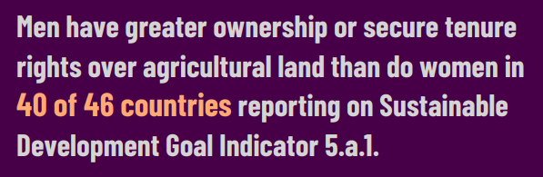
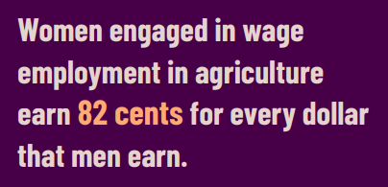
Agrifood systems world context
2023
Notes:
This slide includes some main numbers regarding agrifood systems context (extracted from the report indicated in the right).
The intention here is to evidence the current gender inequalities that still persist in the sector: despite the labor market (paid jobs) seems to employ equally men and women, leadership positions and, thus, salaries, show a significant imbalance towards men.
It is a good moment to mention here that in many underdeveloped countries, self-subsistence farming exists and women are the main workers. A case study on this topic has been included in the Contents section.

Slide 7

Agrifood systems - EU context
% of economic value (€) corresponding to female farm managers
Female % of regular labor force
The value (€) considers the general characteristics of farms, information on their land, livestock and labor force, production methods, rural development measures and agro-environmental aspects that look at the impact of agriculture on the environment.
Notes:
Data is obtained from Eurostat database. Note that data is segregated by sex (not gender)
Left figure: A food note has been included to describe what aspects have been considered to evaluate the economic value of the farms. Hundred % represents the total economic value (considering all farms) and the plot shown the percentage owned by female farm managers.
Right figure: The sex distribution of regular labor force within agrifood industry is shown. Data is obtained from Eurostat database. Note that data is segregated by sex (not gender)
Left figure: A food note has been included to describe what aspects have been considered to evaluate the economic value of the farms. Hundred % represents the total economic value (considering all farms) and the plot shown the percentage owned by female farm managers.
Right figure: The sex distribution of regular labor force within agrifood industry is shown. Countries from Agrigep consortium have been chosen (to be changed for each training and target). It accounts for the most updated data available in Eurostat when this material was prepared for Agrifood project (2024). It is suggested to look for potential updated data within Eurostat in future training editions.It accounts for the most updated data available in Eurostat when this material was prepared for Agrifood project (2024). It is suggested to look for potential updated data within Eurostat in future training editions.

Slide 8
Agrifood systems - EU context
% of Bachelor female students (2021)
Notes:
Data is obtained from Eurostat database.
Countries from Agrigep consortium have been chosen (to be changed for each training and target).
Bachelor female students' distribution is a good representation of the persistent gendered stereotypes within a given context (MSc or PhD could be also influenced by career development and specific university contexts).
It can be seen how studies related to care duties (education and medicine) are feminized whereas ICT and engineering are masculinized. Agrifood systems is a context where parity (or 40-60%) seems more feasible. However, the overall picture demonstrates that gendered stereotypes persist, and this implies that gendered roles and biases are also expected to be found within the agrifood systems context.

Slide 9
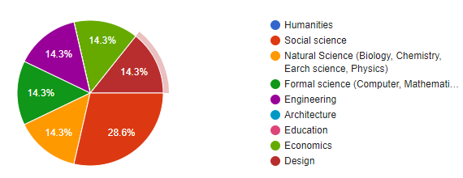
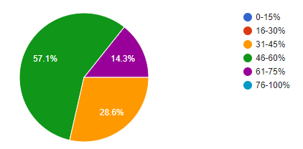
AGRIGEP context
7 answers
Knowledge are (teaching)
  Different attitude among students based on gender
  women are more diligent
  lower self-confidence of women, distribution of tasks (women-administration, organisation)
  different attitudes to learning, different attendance and communication styles
  male students tend to participate more in class (asking questions and replying to questions)
% female students
Notes:
This data was obtained from the Agrigep survey carried out for the “Gender in the Agrifood teaching” training held in 2024. It is strongly recommended to perform an ex-ante survey of the webinar to adapt this data to the current audience.
The figure shows the answer to the following questions:
- top left: Area of knowledge of the participants (educators)
- bottom left: Percentage of female students in their lessons
- top right: Have they observed a different attitude among students based on gender (in their classrooms)?
At the bottom right, some conclusions obtained from an open question where the participants were asked to describe the differences observed.

Slide 10
Activity 1: stereotypes
What are the stereotypes that society has regarding a person who works in engineering?
… and in agrifood systems engineering?

Slide 11


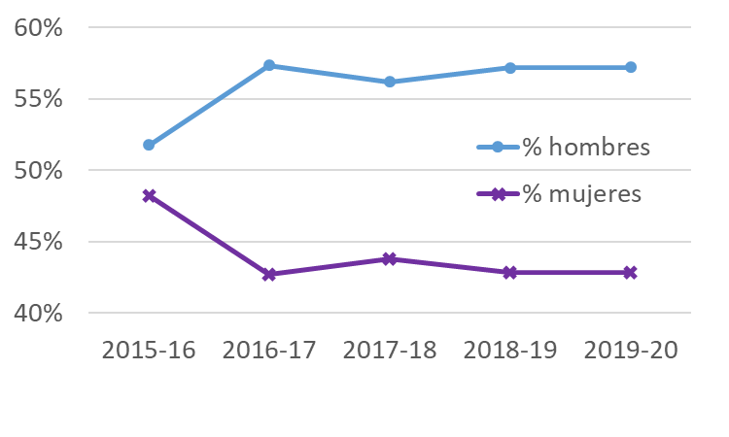



Stereotypes
Google search: engineer
Engineering:
Object-oriented, individual work, …
Google search: mathematician
Mathematician:
Percentage of students in Maths Bachelor (Spain) by sex
Traditionally:
men
Recently:
women
Google search: big data specialist
Notes:
The stereotypes that participants have identified in Activity 1 can be found also in search engines such as Google.
An interesting case is the shift that maths studies and professions have experienced in the latest years, where the stereotype has moved from an almost useless study where the only possible job is becoming a teacher (yielding to a female dominated field), towards the new paradigm of big data (yielding a male dominated field)
Stereotypes have a huge impact on vocations!

Slide 12
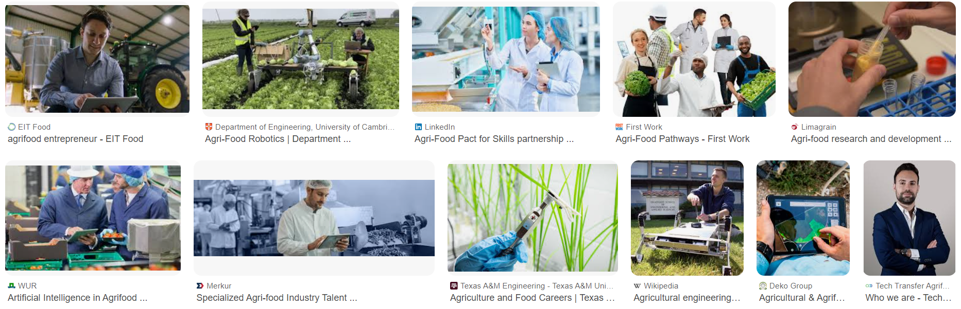
Stereotypes
Agrifood engineering:
Rural context, manual labor, …
Google search: agrifood engineer person
Notes:
When the same search is done for agrifood engineering, the relevance of the rural context and the manual labor becomes evident. This also has a gendered impact on vocations.

Slide 13
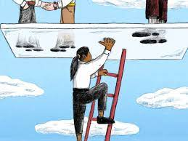

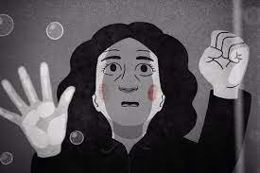
Determinants
Gender-biased stereotypes and roles (family and society in general)
Lack of female role models → invisibility of women, Matilda effect, glass ceiling
Fears and insecurities → impostor syndrome
But…
What concept does society have of success and excellence?
Notes:
It’s crucial to evidence that our vocations are not chosen freely, but are determined (partially) by our context.
In orange: the concept of (professional) success and (academic) excellence is not free of gender biases. Do we consider most successful a man that is leading a huge company than a woman that is educating her children? We tend to relate too much success with salary and, since women are underrepresented in higher positions, the lack of referents reduce their expectations.
In the academia, a similar scenario can be found: universities tend to value more the (man) that publishes a lot and coordinates research projects than the (female) that is focused on teaching and tutoring students (and probably carrying a lot of promotion activities and academic housework).

Slide 14
Contents
Agrifood systems context
Gender in teaching
Agrifood systems examples
Towards the institutional transformation
Recommended readings
Final remarks

Slide 15




Gender mainstreaming
The governance bodies, key actors and decision-makers
Recruitment, career progression and retention
Work and personal life integration
Researchers and research: gender equality and sex and gender perspective
Integration of sex and gender dimension in teaching curricula
https://www.plotina.eu/drafting-the-gep/
Notes:
This slide is designed to explain the gender mainstreaming concept. The webinar will focus on teaching, but it is not enough and this gender dimension should also permeate to other aspects of our institutions.

Slide 16
Basic principles
Gender dimension in teaching
Specific subjects
Transversal approach
Bottom-up
Notes:
All along the webinar, a bottom-up approach is followed, where ALL educators CAN include gender dimension in their teaching. Of course, the existence of specific subjects can be interesting, but the real transformation will be achieved if this transversal approach is followed.
The educator is the promotor of change.

Slide 17



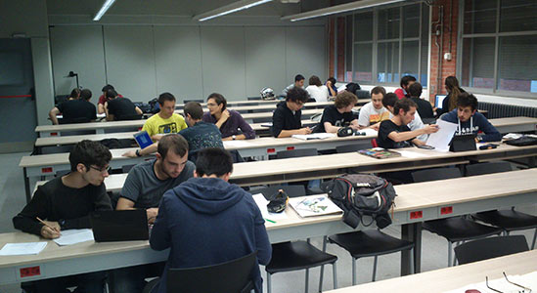
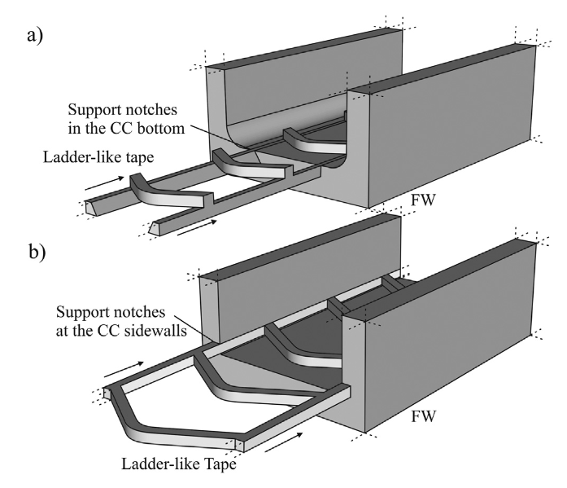
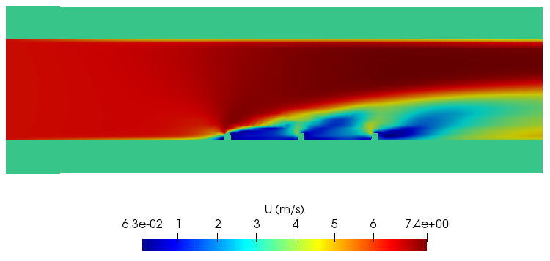
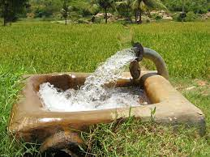
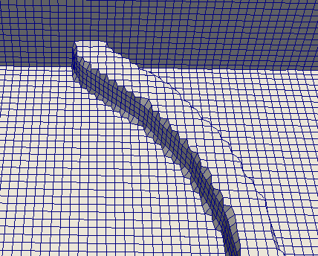
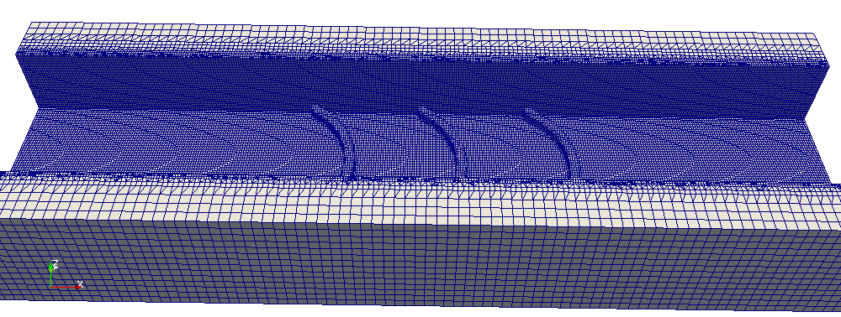
Gender-neutral or gender-blinded?
Notes:
Show the images one by one. Let the participants decide if there is gender dimension in each of the images of the slide. It will become evident that apparent neutral situations can have a GD. For instance:
Male tend to participate more and faster. We can encourage female participation by providing students more time to answer, or by empowering them within each participation.
In building the groups, female students tend to group together to feel more comfortable. Also the roles distribution presents some biases.
Some studies probe that boys perform better in multi-choice tests, probably due to their familiarity with risk
When a man’s body (white, middle age, high socio-economic status) is taken as the reference for any design, ergonomic issues might appear, yielding female (and many other groups) to feel excluded
Even in a very technological subject where numerical simulations are the focus of the learning, some gender aspects in the contents can be included as, for instance, in the authorship of the journal papers read to design the case study.
Even in apparently simple cases of study regarding water management, gender issues appear (the control of the water management is not equally distributed).
Clarify the difference between gender-neutral and gender-blinded.

Slide 18

Gender blindness and its implications
Gender-neutral….. or gender-blind?
Masculinization of the professional and academic culture of the discipline
Impact:
Low proportion of female students in engineering
Perpetuation of stereotypes
Under-representation of women in engineering decision-making bodies
Gender-blind research for the society
Notes:
Typically STEM studies have been considered to be gender-neutral (as a positive characteristics!), but when a closer insight is achieved, it becomes evident that they are gender-blinded, yielding to several social impacts.

Slide 19

Basic principles
Learning outcomes
Gender competence
Utility
Tools, typologies,…
Assessment
Contents
Female referents, biography
Participation
Learning environment
Methodology
Inclusive and non-sexist languages and images
PBL, Service-Learning, debates, role-plays…
Teams, roles, leadership…
Notes:
This is the core of the training.
Participants should realize that all four pillars should be colored by the gender dimension, rather that only the contents one. This will facilitate the task and open the door for beginners (the learning environment and the methodology pillars are far easier).

Slide 20
Methodology
  Active methodologies (as promoters for human dimension)
    Lower competitiveness and more collaboration
    Building healthy self-confidence
    Reduction of stereotypes
  Self-efficiency → referent female engineers
  Ex ante & ex post → action research
Notes:
No special methodology is here proposed for including the gender dimension, but active learning methodologies provide a favorable context to work with interpersonal skills and, thus, to work on stereotypes and biases. As an example, let's consider a Project Base Learning methodology: usually the project is carried out within a teamwork and then it allows us to deeply work in roles and their corresponding stereotypes (see slide #22). Also, in a role-play one can explicitly discuss on some gendered stereotypes, gendered priorities, etc. These are just two examples but the main points are:
1. Active methodologies force students' interaction and, thus, allows us to explicitly discuss biases and gender stereotypes
2. Active methodologies tend to require multiple assessment instruments (a report, an oral defense, some peer-evaluation, etc), providing students with a more diverse spectra of instruments and, thus, more adapted to each individual.
Low levels of self-efficiency has proven to be one of the barriers for women to enrol in a STEM field. These low levels can be also observed among female STEM students. Thus, we as educators can try to support their self-perception by introducing some female referents.
The ex-ante and ex-post surveys can help us improving the webinar, following an action research methodology.

Slide 21
Learning environment
  Female students participation
  Gender-sensitive language
  Egalitarian visual resources
  Teamwork gender distribution and roles
Universitat Politècnica de Catalunya: Third person pronouns
(he/she, him/her → plural they, their, ...)
Notes:
These are some hints on how to include the GD in the learning environment.
Ask some participants to explain their own experience in managing students’ participation and/or in managing teamwork. Have they observed that boys participate more? Have they observed that girls tend to group among them in teamwork? Have they observed gendered roles in the task distribution within a teamwork context?
An example of a brief language guide from Universitat Politècnica de Catalunya is here proposed, but the facilitator is encouraged to include other guides from their own institution.

Slide 22


Learning environment
Susana Gaytán (2016)
Students’ distribution
Topic (SDG)
Educator’s sustainability
Rotative roles,
Leadership, belonging, cooperation
Co/self/-assessment
Pre/post-test
  Project Based Learning (PBL) & teamwork
Laura Hirshfield & Milo D. Koretsky (2018)
Sarah Hofer (2015)
Carina S. González-González et. al. (2018)
Notes:
This is an example on hoe an active learning methodology where students work in teams can support the inclusion of the GD. There are some references for 3 of the topics that can guide the facilitators and provide some examples for the participants.
The topic, when aligned to the SDG, can enhance the environmental and social impact of the project, what has proven to be of most interest for female students.
Educator’s sustainability, in terms of time resources, is crucial in order to correctly guide the students, provide the appropriate feedback and keep the schedule (and health).

Slide 23

Contents
Survey 2019
548 students
16 courses
7 Bachelor and Master degrees
→ male/female referents
 | Male students | Female students
Male referents | Actual and from the field of study | Belonging from the personal circle
Female referents | Belonging from the personal circle or UPC teaching staff
Notes:
One of the more basic actions when including a gender dimension in teaching is the presentation of female contributions within the area of knowledge. Those female act a referents (and role models) for students, enhancing empowerment of female students.
But, up to which extend do students have either male or female referents? We analysed it through a suvey hold at UPC (Universitat Politècnica de Catalunya), within the frame of a teaching innovation project in 2019.
Students were asked to identify (with names) male and female referents within their area of knowledge.
Some conclusions:
- A significant amount of students (more than 40% regardless of the sex) does not know any referent.
- It is more likely that students have a male referent. This justify the need to include female referents in the teaching.
- For male students, the male referents are known referents (national or international ones) whereas female referents mainly belong to their personal circle. For female students, all referents belong to their personal circle. It is urgent to include well known female referents (national or international ones).

Slide 24
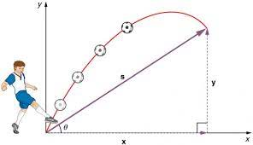
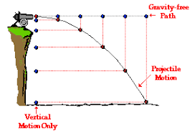
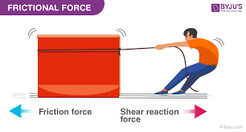
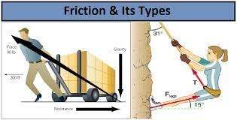
Contents
Fundamentals
Examples: calculus, algebra, physics, statistics…
Focus: contextualization
Google “Parabolic movement”:
Google “Friction force”:
Notes:
The graphs are examples that are typically used to explain physics (either at high school or at the first year of the Bachelor Degree) and it makes evident the urgent need to include gender in these examples. There is always a man doing something related to football, war or non-sense things. Only in the right figure we see some examples of both a man and a women doing specific things that we can relate to our life.
We should try to include significant examples when explaining the fundamentals of any science.

Slide 25
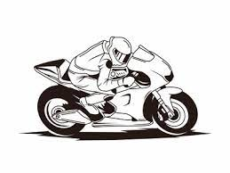

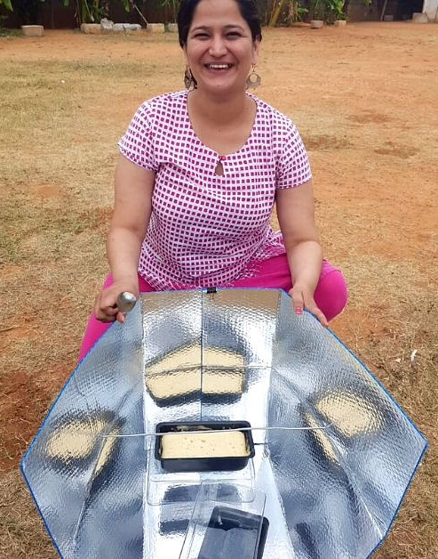


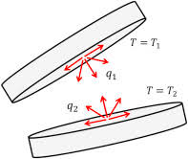
Contents
Technologies
Examples: heat transfer, electrotechnics, …
Focus: + safety, environment, ergonomic, SDG, consumption paths, …
Service-learning: Building improvement: energy, accessibility, acoustics, ventilation, ...
  Address the realities of both women and men
  Sex and/or gender variables as study variables
  In surveys and data collection disaggregate by sex (& gender) & analyze possible differences and actions to take
  Representativeness of the sample group
  Inclusive and non-sexist language (and images)
Notes:
A technology can be explained on an object-oriented basis or can include some focus on the humans that are going to use it, the environmental impacts, the social impacts, ....
Statistics show that female are more interested in environment and in social aspects, so we should try to colour STEM studies with this very useful aspects.

Slide 26

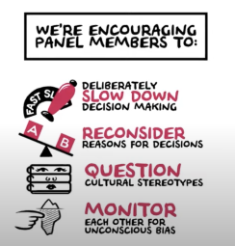
Contents
Management
Examples: projects, organization, human resources, …
Focus: + + gender in interpersonal relationships, recruitment, work-life balance, …
Discussions regarding gender gaps and biases in the selection processes and promotion
In projects or case studies, team analysis:
Gender parity in teams, work-life balance, and career progression
Transparent and bias-free hiring
Monitoring
Notes:
The management subjects are strongly related to persons, workers and users. So the GD must be included in all of their contents.
She Figures and Eurostat databases can be very useful in showing current statistics and raise awareness.

Slide 27
Contents
Fundamentals
Examples: calculus, algebra, physics, statistics…
Focus: contextualization
Technologies
Examples: heat transfer, electrotechnics, …
Focus: + safety, environment, ergonomic, SDG, consumption paths, …
Management
Examples: projects, organization, human resources, …
Focus: + + gender in interpersonal relationships, recruitment, work-life balance, …

Slide 28
Assessment
Is it relevant? Then, it must be assessed
Tools:
  Open question or multiple-choice test?
  Contextualised questions
Types:
  formative, feedback
  Pros & cons of co/self-assessment
Student involvement: when, how, why
Unconscious bias by the educator!
Notes:
If we really trust that GD is relevant (in any of the 4 pillars), we should assess it.
There’s a lot of literature regarding the GD in the definition of the instruments. Refer to chapter 4 of (Mas de les Valls & Peña, 2022) for a brief summary.

Slide 29
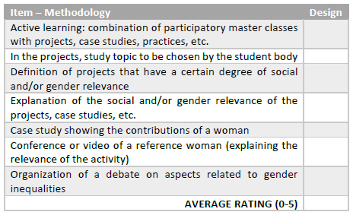
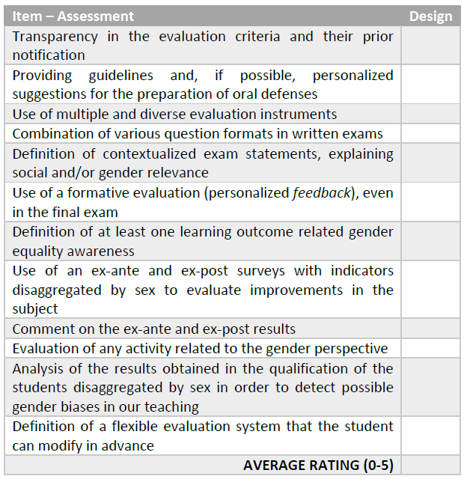
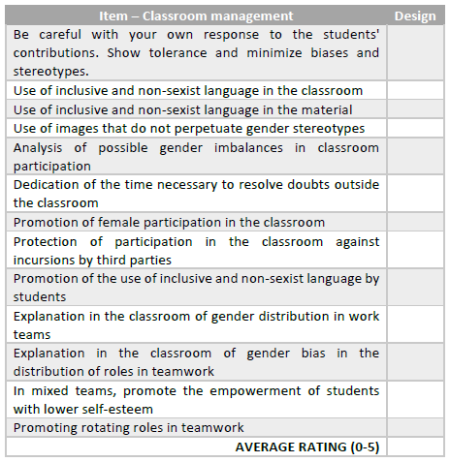
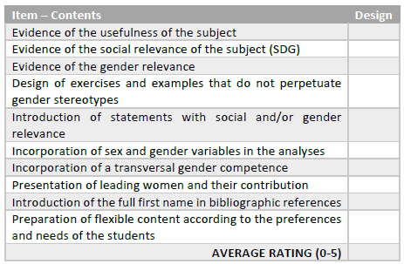
Activity 2: checklist
Notes:
At this point the trainer makes available the checklist to each participant (in paper if the training is in-person and in digital form if the training is online).
The trainer asks each participant to carefully read each of the items of the checklist and try to perform a self-assessment by writing grades (between 0 and 5, or NA if required) to each item.
The checklist includes 4 tables, one per pillar. An average grade needs to be calculated for each pillar and written in the MIRO board.

Slide 30

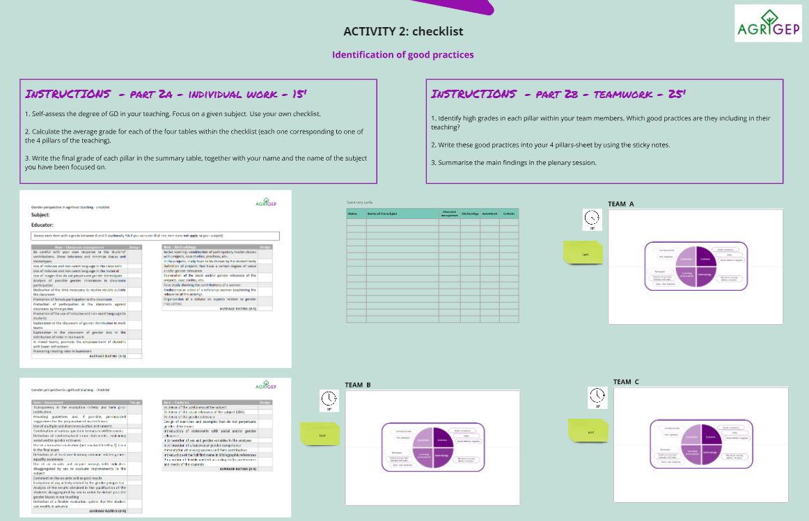
Activity 2: checklist
Time | Program
10 min. | Individually, fill-out the checklist
5 min. | Write your grades in the summary table in MIRO
Notes:
This is an image of the MIRO board.
The check list is used as a self-assessment instrument for each participant (individually). Only the averaged grades for each of the 4 pillars will be written in the summary table in the MIRO board.

Slide 31
Activity 2: checklist
Time | Program
15 min. | Teamwork
10 min. | Sharing & wrap-up
Notes:
Within teams of 4-5 participants, identify the bests grades for each pillar and the good practices that have yield to these grades. This good practices are written then in the 4 pillar sheet by using sticky notes.
The last 10 minutes are used in the plenary session for sharing ideas and good practices.

Slide 32

The syllabus
URGENT:
To make explicit the social and human dimension of (most of) the engineering subjects.
Syllabus
Goals
Contents
Methodology
Assessment
References
Notes:
At this point of the training, the four pillars have been discussed and some strategies to include gender dimension in the teaching have been presented. However, there's still a difficult step: to formalize it within the syllabus of the subject.
Being able to include the gender dimension in the syllabus is a step forward. It means not only that the educator wants to include this gender dimension, but that they is so convinced that is able to make it explicit in the syllabus.
Here the syllabus is seen as an open document were the educator describes their teaching and the rules throughout the course, it can bee described as a contract between the educator and the student.
Discussion: how to participants feel when they are asked to include explicit references of the GD in their teaching in the syllabus?

Slide 33
Educators’ resistances
ID | Description | Action
1 | Resentment against men (due to personal experiences or to cultural heritage). It appears at the very beginning of the training. | Ask participants to maintain their focus on identifying and implementing changes within their own lessons and teaching activities. If done properly, no extra incidents appear.
2 | Gender-blinded (unexperienced) participants | Promote discussion on statistical data and examples to raise awareness (Carreiro-Otero et al., 2021).
3 | Lack of consensus on how to reach equity in students’ participation | Present and discuss different strategies to promote equal participation. The “one size fits all” cannot be applied.
4 | “How can I include gender contents in my gender-neutral subject?” (STEM participants) | Indicate that STEM subjects are not gender-neutral and behind any technology or strategy one can find users, beneficiaries or conceptualists (among others), what represents a source of gender-biased concepts and an opportunity to promote gender equality.
5 | Fear against students’ and mates’ resistances | Promote a gradual and natural introduction of gender dimension, while realising that the subject benefits from it. Sometimes it is easier when the word ‘gender’ is changed by ‘human’ in order to gain acceptance within the non-gender-awareness teaching staff
6 | Difficulties in making gender explicit in the teaching guide | Provide a sustained support on the transformation of the teaching guide. Do not rush the participants.
7 | Lack of time | Define a minimum participation to reach the training certificate as a pressure measure for the lack of self-regulation scenario (Barak et al., 2016). The University and the Administration should define some incentives for educators by putting in value teaching activities in their professional assessment.
Notes:
The text in the table might be reduced, but it has been kept like this for a better comprehension of the facilitator.

Slide 34
Contents
Agrifood systems context
Gender in teaching
Agrifood systems examples
Towards the institutional transformation
Recommended readings
Final remarks
Notes:
In the following slides some examples are provided. They are presented as part of research studies, what indicates that they can easily be included within a PBL methodology.
Be sure that the key aspects for each example are not explained at the very beginning. Start asking the audience how would they relate each example with one or more of the 4 pillars.

Slide 35
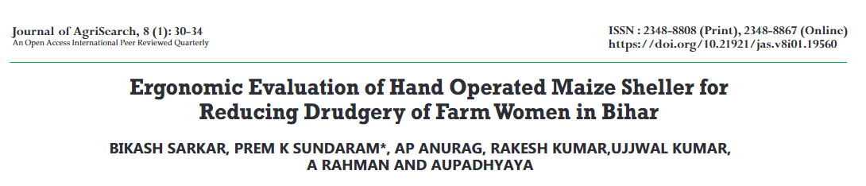
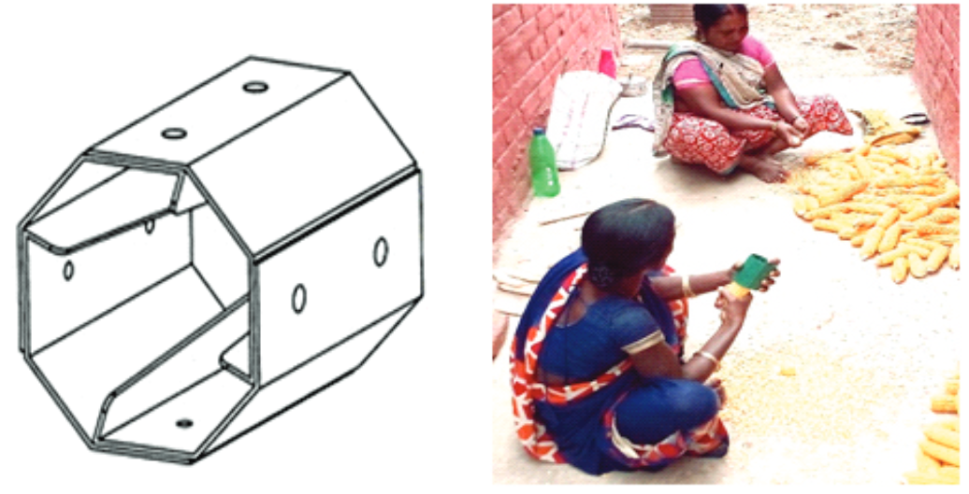


Subject: machinery & mechanization
Enginyeries Agraries: guies per a una docència universitària amb perspectiva de gènere.
Raigón Jiménez, María Dolores (Xarxa Vives d'Universitats, 2022)
Notes:
In this research study it can be observed that improving the design of a tool has social consequences, sometimes, far beyond the first impression.
In the example, the new design of the Hand Operated Maize Sheller changed the life of a specific sector of the population: farm women. If we do not analyze the users of our designs (or target population) and the impact of our designs on their life with a gender perspective, we will miss the real impact of our engineering solutions.
Often, just the opposite scenario occurs: many technologies or solutions benefit more men than women and, since no gender perspective is included, the gender inequalities persist.
Analyzing the solutions and their impact is referred as using the gender lens. Note that, in this case, we are improving womens' life, but without changing the gendered roles existing in the context. How could we further help these women? - next slide explains the concept of appropriate technology
Note that the link to the journal paper is included as an hyperlink on the image.

Slide 36
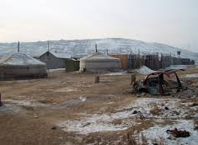
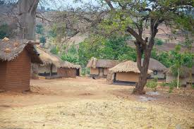
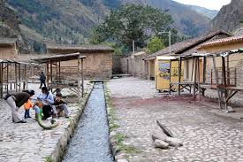

Concept: Appropriate technology
Suitable for the specific social, economic and environmental conditions of a particular community or context.
Sustainable solutions (often simple, affordable, and adaptable)
Prioritise accessibility, local participation and empowerment.
improve living standards
minimizing negative impacts on the environment
Notes:
Within the concept of appropriate technologies we include: Technologies, techniques or approaches
An appropriate technology can encompass a wide range of innovations from renewable energy systems and water purification methods, to agricultural tools and healthcare solutions tailored to the specific needs and resources of the intended users.
Combining the concept of appropriate technology and the concept of gender lens, new and equitable solutions may appear. A reminder to this sentence has been included under the shape of pink glasses.

Slide 37

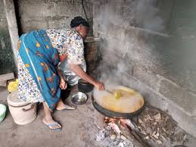
Case study: cooking in a Sub-Saharan Africa
Impacts:
Deforestation - loss of biodiversity, soil erosion, and reduction of CO2 sequestration - climate change!
Indoor air pollution - respiratory diseases – women and children!
time and labor intensive: loss of opportunity!
Notes:
Details for each impact:
Deforestation: the high demand for fuel would for cooking contributes to deforestation in many parts of Africa. Deforestation leads to loss of biodiversity, soil erosion, and reduce carbon sequestration, exacerbating environmental degradation and climate change
Cooking with wood often involves inefficient combustion leading to indoor air pollution. Exposure to smoke and harmful pollutants can cause respiratory diseases such as asthma, pneumonia, and lung cancer, particularly affecting women and children who spend more time near the cooking area.
Time and labor intensive: collecting fuel would be a time consuming and physically demanding task. Time spent gathering wood could otherwise be used for education and income generating activities.
Gender lens: we have identified here that women (and children) receive the highest impact. This impact is not only about health, but also of loss of opportunity.
This is a good moment to recall about the challenges of African rural women (patriarchal society with lots of gender stereotypes and cultural norms that limit women empowerment and access to land and decision making positions).

Slide 38
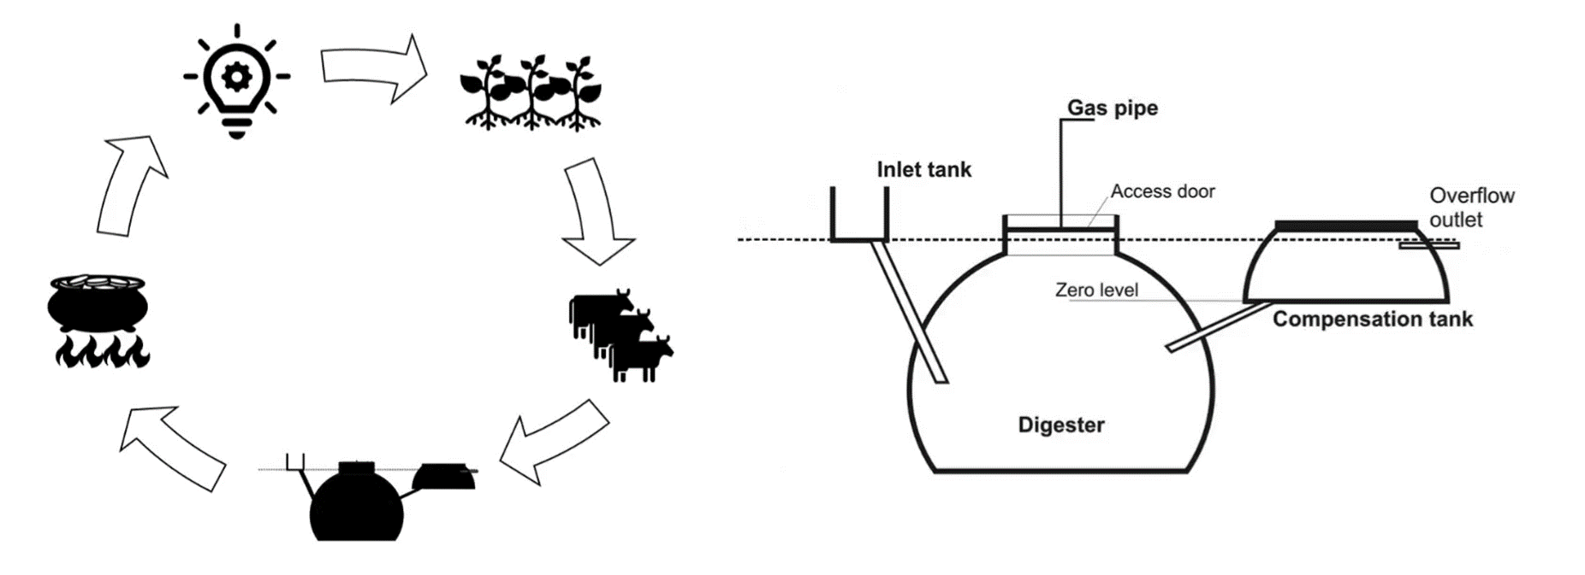
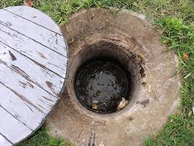
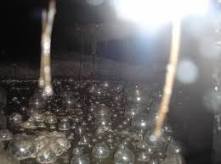
Case study: cooking in a Sub-Saharan Africa
Appropriate technology: Biogas technology
From organic waste to usable energy
Reforestation
New time distribution
X Risk: gendered norms (decision, benefits)
Vertical and horizontal coalitions: women in management operation and decision-making processes
Shift power dynamics within households and communities
Notes:
Advantages:
New CO2 cycle is used, allowing for reforestation and a sustainable forest management.
Women have more time and are exposed to a lower health risk. So they could occupy more leadership positions.
However:
According to the stereotypes, decisions will be taken only by males (installation place, daily operation, maintenance). Thus, females will probably keep doing the daily operations of the plant (collecting waste, feed the digester and cooking). This division of labor can lead to unequal burdens, where women take on additional work without necessarily gaining access to the benefits.
Men might gain the most from the financial or business aspects (biogas or fertilizer sales)
Women may primarily benefit from the household energy provided by the biogas which can reduce their workload related to firewood collection or cooking.
New social gain: community status or control over technological knowledge. Would it be possible that women owns this knowledge? Would they become involved in the management operation and decision making processes surrounding biogas systems?
To empower women:
horizontal coalitions: women's cooperatives or community groups
vertical coalitions: alliances with local governments and NGOs (enhancing the communal use and maintenance of biogas systems while providing women with platforms for collective decision making and advocacy on a personal level)
Result: shift power dynamics within households and communities.

Slide 39
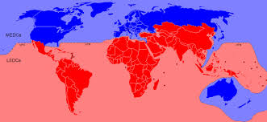
Different contexts
Global North and Global South
Notes:
The effects of the gender lens are more easily understood in developing countries than in developed ones, mainly because poverty is not so evident and gender stereotypes and biases are, too often, not identified on our daily life. In the following slides, some examples applied to the Global North are described.

Slide 40
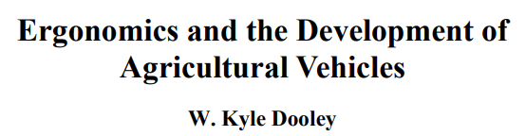
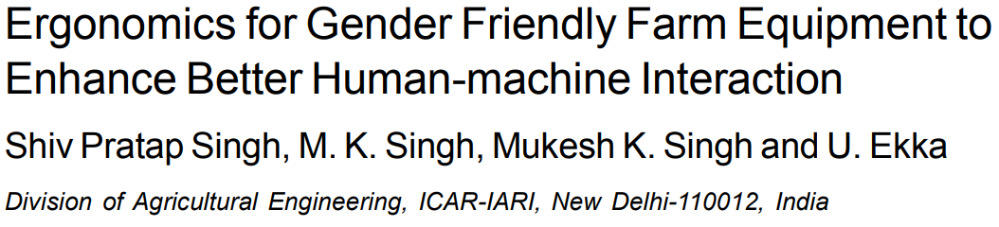

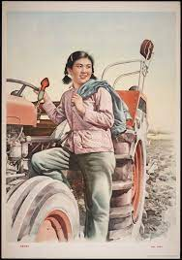
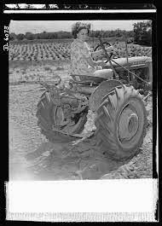
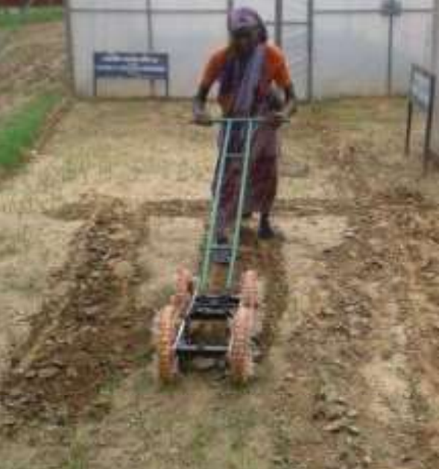

Subject: machinery & mechanization
The best possible ergonomic match maximizes an operator’s effectiveness, comfort and system safety. For every ergonomic mismatch, you are deducting from your ideal productivity, costing time and money.
Notes:
These research papers focus the attention into the ergonomics of agricultural vehicles. If the design considers only the typical heigh and weight of white middle-aged males, a significant sector of the users are not taken into account. Then, surprising scenarios might appear, as that where the security system blocked a female to drive a tractor assuming she was a kid.
In ergonomics, if the users' sex is not taken as a design variable, a bias in the design will exist.
Note that the links to the journal papers are included as hyperlinks on the images.

Slide 41
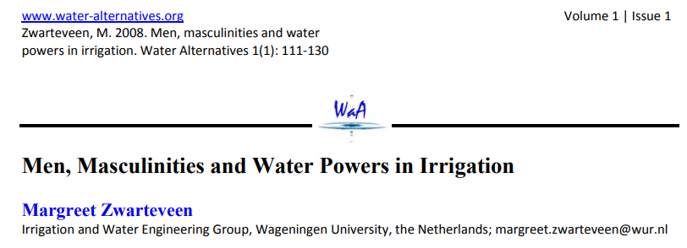

Subject: irrigation engineering
Enginyeries Agraries: guies per a una docència universitària amb perspectiva de gènere.
Raigón Jiménez, María Dolores (Xarxa Vives d'Universitats, 2022)
Notes:
Imbalanced power distribution is usually not discussed in class, but the consequences of it are huge. Agrifood professionals should have this holistic view of the field of knowledge and try to reduce existing biases.
In the example it is studied how the fact that the water management is decided by a males' population, their decisions are biased and gender inequalities persist. Also, the concept of gender-neutrality and its risks is commented.
Note that the link to the journal paper is included as an hyperlink on the image.

Slide 42

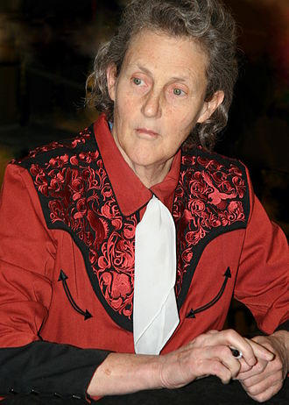
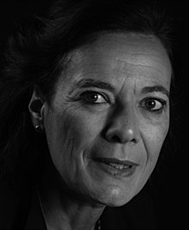




Female role-models
Mary Temple Grandin (1947)
Her innovative designs for livestock handling facilities have revolutionized the way animals are handled and processed in the agricultural sector.
Louise Fresco (1952)
Her work focuses on the intersection of science, technology, and society, particularly in the context of food production.
Mary-Dell Chilton (1939)
Her work on plant genetic engineering has been instrumental in the development of genetically modified crops, significantly impacting the agro-food industry.
Notes:
These are female role-models within agrifood context. One of the activities to include a gender dimension in the teaching consists in making visible the contributions of women in the knowledge area.
The existence of awards and recognitions is something that puts in value all the efforts that are being carried out in empowering female within agrifood context. Commenting on it at class can rise awareness and become a source of debate.

Slide 43

Female role-models
2023 (3)

Slide 44

Activity 3: stakeholders – social relevance
Product – solution of a problem:
Design of a genetically modified crop
Design of a tractor
Design of the irrigation strategy for an agricultural area
Time | Program
5 min. | Choose a product/solution
5 min. | Identify 3 stakeholders
15 min. | Identify needs and preferences for each stakeholders. Is gender relevant?
10 min. | Sharing and wrap-up
Notes:
Very often gender or sex appears to be relevant in the product or solution that we design, but is difficult to see it.
In this exercise we propose to reach to the gender impact through the analysis of the stakeholders.
The activity consists in two parts carried out in team (and a third one for sharing results in plenary):
Each group identifies a given agrifood product or solution, 3 stakeholders for that solution, and needs and preferences for each stakeholder.
Each group discusses if gender is relevant in these needs and preferences previously identified. If so, discuss if the product/solution can be reformulated in order to reach equity.
For instance, the tractor case:
Stakeholder: the farmer that is using it. He or she wants that the tractor works for a long time, that it is cheap and comfortable. Discussion: the ergonomics might depend on sex; prices depend on the available budget (how the agrifood economy is distributed among men and women?); the duration of the tractor might be more relevant for the farm owner than for a simple worker (how is the labor marked distributed among men/women?). Then, how can we design a tractor focused on covering the needs of female farmers?
Stakeholder: the CEO of the company that manufactures the tractor. He/she wants to build something cheap that can be sold well, with reasonably high prices (what about guarantees? Qualities?...). How the CEOs within the sector are distributed among men and women? Can we design a product that offers quality and that is environmentally friendly, and also benefits for the production companies? (can we humanize the agrifood sector in order to get a holistic point of view of the solutions by including not only technical and economical aspects, but also environmental and social aspects?)
This exercise could also be carried out within a PBL methodology in class.

Slide 45
Contents
Agrifood systems context
Gender in teaching
Agrifood systems examples
Towards the institutional transformation
Recommended readings
Final remarks

Slide 46
Regulations
Institution
Staff
Notes:
The real transformation is based on these 3 factors or pillars.
In a bottom-up approach, the staff can promote a change but it might not be significant in terms that not all community staff will be involved. We also need to act at the institutional level and, as far as possible, on the regulations (or use them to push forward the transformation!)

Slide 47
Regulations
The Spanish case:
Several laws on education and, specially University education, include:
  Equality principles
  Gender dimension in teaching and research
  Transversal gender competence
But….the real level of inclusion of the gender perspective is low

Slide 48

Regulations
Pioneering initiative in 2018 (Spain):
  General framework for incorporating the
  gender perspective in higher education teaching
  To be applied in all degree programmes at Catalan universities
  In assessment, monitoring, modification and accreditation
Catalan University Quality Assurance Agency

Slide 49


Regulations → guides

Slide 50

Regulations → guides

Slide 51








Regulations → guides
Guides of the Vives University Network for university teaching (Spain)
First guides published in 2018. At present: 29 guides (11 in STEM fields)
Recognized by the European Institute for Gender Equality (EIGE) as an example of good practice in its GEAR Toolkit
Agricultural engineering (2022)

Slide 52

Institution
GEP with a devoted action of Gender in Teaching.
Available resources and guidelines (web, guides, …).
Gender in Final Degree Projects. Awards.
Gender-specific subjects. Mandatory versus elective subjects.
Devoted vice rectorate, Equality Unit and Committee, Gender experts (Faculty/Department).
Gender-specific competence and learning outcomes (apart from the sustainability one).
Create the Teaching innovation day (with gender dimension in teaching).
Teaching innovation projects with gender dimension.
Trainings for educators (from an overview to a real transformation of the syllabus).
Recognition of the gender implication (in the assessment of excellence).

Slide 53



Institution
Trainings for educators → transformation of the syllabus
Basic guide review
Inclusive and non-sexist language.
Gender competences.
Bibliography with full names.
Classroom management (glimpsing rotating roles, etc.)
Assessment with gender equality (diverse tools, etc.)
Backstage work: a new gender activity
Focus on minimum one activity to include gender dimension.
Wildcard:
Fundamentals: female contributions.
Technologies: teamwork project or challenge.
Management: case study or role-play.
Extended guide review
Make gender aspects explicit in the subject's general description and the contents.
Include at least one learning output and the corresponding assessment related to the new gender activity.
Assessment
Contents
Learning environment
Methodology
Notes:
This is the basis for the transformative training, where participants are asked to transform the syllabus of one of their subjects.

Slide 54

Institution
Gender in Final Bachelor/Master Degree Projects
Required studies:
economical,
environmental,
social and gender equality
Format: Language, images, female authors in references
Teamwork: gender distribution, roles, …
Methodology: gender/sex as variable of the study
Results: Impacts, potential biases
Notes:
Some universities include awards to Bachelor and Master final degree theses. But here a different strategy is proposed: to ask students to include the Social and Gender impact in their theses.
The example of the Universitat Politècnica de Catalunya is shown, where a template is given to the students with detailed indications on how to fill each section, including this social and gender impact. For instance, students can analyze the gender balance in the team (or in the field of study), must include an inclusive and non-sexist language in the report, can write the full name of the authors to make visible the (lack) of women and analyze its percentage, can include gender or sex as a variable of study in surveys, and analyze the impact of a given technology (similarly to Activity 3).

Slide 55
Staff
Keep your teaching alive (and monitor it). Reminder: the four pillars.
Disseminate your experiences (within your mates and abroad).
Participate in the teaching innovation projects with gender dimension (raise awareness, sharing experiences, reaching transformation, spreading expertise).
2019
Notes:
Staff could design and participate in innovation projects to adapt the learnings of the training to their own university context.
Here, the example carried out at Universitat Politècnica de Catalunya, in 2019, is summarised. See (Peña et al., 2021) for further information.

Slide 56
Contents
Agrifood systems context
Gender in teaching
Agrifood systems examples
Towards the institutional transformation
Recommended readings
Final remarks

Slide 57
Recommended readings
Top 10 reads on women’s work in agri-food systems, Niyati Singaraju, CGIAR GENDER Impact Platform, 28th June 2023
Enginyeries Agraries: guies per a una docència universitària amb perspectiva de gènere. Raigón Jiménez, María Dolores. Xarxa Vives d'Universitats, 2022
Agricultural Studies. Syllabus by Prof. Dr. Christine Bauhardt, M.A. Meike Brückner, July 2018
Toolkit for Integrating Gender-Sensitive Approach into Research and Teaching, Jovana Mihajlovic Trbovc and Ana Hofman, Garcia Working Papers n. 6, 2015
Gender equality in academia and research. GEAR tool, European Institute for Gender Equality, 2016
A guide for Gender Equality in Teaching Education Policy and Practices, United Nations Educational, Scientific and Cultural Organization, 2015
Guide of Industrial Engineering to mainstreaming gender in university teaching, Elisabet Mas de les Valls and Marta Peña, Xarxa Vives d’universitats, 2020
Notes:
If desired, extend the list of recommended readings.

Slide 58
Recommended readings
STEM vocations:
  Milagros Sáinz et al. (2020) Gendered Motivations to Pursue Male-Dominated STEM Careers Among Spanish Young People: A Qualitative Study. J. of Career Development 47 (4): 408-423
  Susana González-Pérez et al. (2020) Girls in STEM: Is It a Female Role-Model Thing? Frontiers in Psychology, vol. 11, 2204
Assessment:
  Rasooli A, Zandi H, DeLuca C (2018) Re-conceptualizing classroom assessment fairness: A systematic meta-ethnography of assessment literature and beyond. Stud. Educ. Eval. 56: 164–181
  Sarah I. Hofer (2015) Studying Gender Bias in Physics Grading: The role of teaching experience and country, International Journal of Science Education, 37:17, 2879-2905
  Filip Dochy, Mien Segers and Dominique Sluijsmans (1999). The sue of self-. peer and co-assessment in higher education: A review. Studies in Higher Education , 24:3, 331-350.
  Menucha Birenbaum and Rose A. Feldman (1998). Relationships between learning patterns and attitudes towards two assessment formats, Educational Research, 40:1, 90-98
Notes:
If desired, extend the list of recommended readings.

Slide 59
Recommended readings
(…) Assessment:
  Tuomas Pekkarinen (2015). Gender differences in behaviour under competitive pressure: Evidence on omission patterns in university entrance examinations. J. Econ. Behav. Organ, 115, 94–110
  Gerhard Riener and Valentin Wagner (2017). Shying away from demanding tasks? Experimental evidence on gender differences in answering multiplechoice questions. Econ. Educ. Rev., 59, 43–62
Reflection:
  Thamar Heijstra et. al. (2017) Testing the concept of academic housework in a European setting: Part of academic career-making or gender barrier to the top?. EERJ, vol. 16 (2-3) 200-214
Methodology and classroom management:
  Laura Hirshfield and Milo D. Koretsky. (2018). Gender and Participation in an Engineering Problem-Based Learning Environment. Interdisciplinary Journal of Problem-Based Learning, 12(1).

Slide 60
Contents
Agrifood systems context
Gender in teaching
Agrifood systems examples
Towards the institutional transformation
Recommended readings
Final remarks

Slide 61
Final remarks
The agrifood context is still male dominated → actions are required.
Gender dimension can be included in all subjects (4 pillars).
Guides and tools are widely available.
Resistances will appear → a sustained support by the institution is required.
Teaching innovation projects must be promoted by the institution to reach a natural and bottom-up transformation.

Slide 62
Exit questionnaire
Your opinion is important to us!
QR code or short link

Slide 63
Hands-on in Including Gender in Agrifood Systems Teaching
Date
Facilitator’s name and email address
Notes:
Why is it relevant?
EU policies:
1995 Beijing conference where the word ‘gender’ appeared for the first time,
2007 Council of Europe issued a recommendation on gender mainstreaming in education,
2015 Paris declaration and Commission/Council for non-discrimination,
2015 launched and adopted the European Framework for Education 2030 equal opportunity for all, guidelines started to appear

